Slide 1
Creating play spaces

Slide 2
What is play?
Children play in many different ways according to their own interests and abilities, and enjoy different forms of play at different times and places. Approximately 15 different play types have been identified, all of which are of importance to children’s enjoyment and day-to-day experience. (Children’s Play Council, National Playing Fields Association and PLAYLINK, 2000).
Play is about more than just ‘letting off steam’; it can be quiet and contemplative, as well as active and boisterous.
All children and young people, including those who are disabled or have specific needs, should have opportunities to experience challenge and take risks while playing.
Play is essential to the healthy development of children and young people – not just their physical development, but their social and cognitive development too.
Playing allows children to develop a sense of well-being, develops their emotional responses and improves their interpersonal skills. It involves exploration and creativity, helping children think in a flexible manner, developing the creative process, language skills, and learning and problem solving skills.

Slide 3
Whether at home or within a child care or preschool environment, creating rich, playful spaces for children inspires them…
Inspires them to play in more purposeful, meaningful ways.
-Inspires them to learn through those play experiences. - Inspires them to value what they have.
Inspires them to help maintain the space in an organised way.
Inspires who they become… “The space we live in has a powerful influence over us, particularly the space we grew up in… “The spaces that teachers [parents/child care educators] create for children seem to hold enduring memories for them that have a powerful influence on what that will value later in life.” -Susan Fraser, Authentic Childhood, 2000 –
Subscribe to the below link for more useful information:
http://childhood101.com/2010/06/space-to-play-and-learn-10-tips-for-creating-great-play-spaces/#sthash.PzCFOJ3U.dpuf

Slide 4
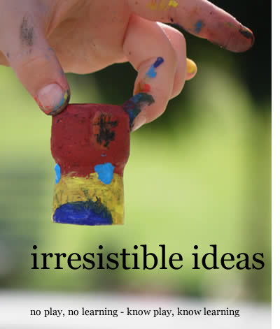
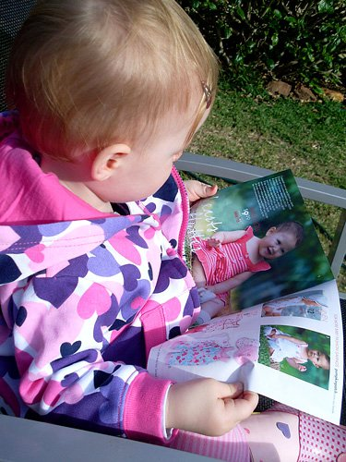
10 Tips for Creating a Great Space to Play [and Learn]
Great play [and learning] spaces for children of any age is one which;
Is welcoming, inspiring and engaging The space should feel nurturing and familiar at the same time as inviting children to explore and investigate by capturing their attention and provoking their interactions with the space.
2. Is rich with good quality children’s literature and a range of ‘texts’ – fiction, non fiction, magazines, catalogues, maps, menus, brochures, photo albums Encouraging children to see reading (and writing) as both enjoyable and useful from a young age can be achieved by engaging them with a range of texts. For example, a child who is less interested in story time may enjoy looking at and talking to you about the map of a zoo from a recent outing.

Slide 5
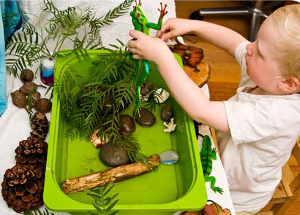
3. Includes space for using and easily storing a range of creative materials Creative materials provide children with the opportunity to express their knowledge, ideas, theories and feelings about the world. Having a system and space for using and storing pencils, paints, crayons, glue, scissors, etc, will make the use and clean up easier and more efficient, which is what every educator needs
Includes elements of nature and natural materials The natural colours and textures of materials such as stones, seedpods, pinecones, tree blocks, and wool, make a
nice change from the bright colours and flashing lights
of many modern day toys. They also encourage children to play more creatively as seedpods become ‘food’ in their home corner play or pinecones a ‘family’ enjoying a day out.

Slide 6
5. The majority of toys are ‘open ended,’ allowing for active exploration and many different types of play Before purchasing a toy consider if it is something which can be used flexibly, in many creative ways. These are they toys which will be worth the hard earned dollars you spend on them as they will offer an infinite number of new play scenarios, and not just now but for many years to come.
6. Feels cozy and comfortable, with a sense of homeliness achieved through including sentimental family items and/or beautiful objects Plants, photos in frames, thoughtfully displayed artworks, cushions – all create a sense of homeliness. By including objects important to the family, you have an opportunity to help children learn to treasure and respect their belongings and those of others.
7. Includes areas where children can play together or alone Children need time and space to play both alone and with others. By setting up an activity at a small table with just one chair (or alternatively two or more chairs), you are providing an indication of how that space should be used Consider a balance of small, independent play and larger, collaborative play spaces when planning your space

Slide 7
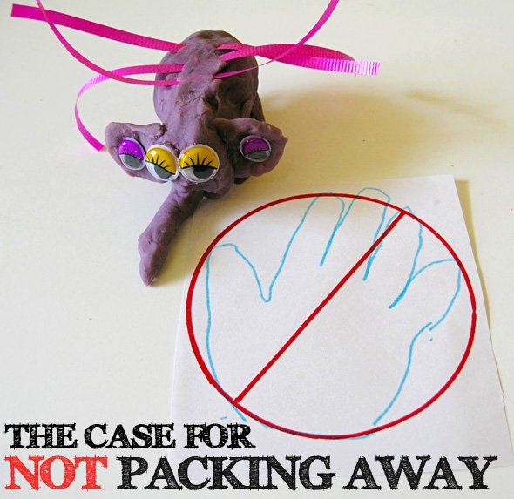
8. Includes space for ‘works’ in progress Know when it is NOT so important to pack away and have a plan in place to store important works in progress
Children need time to see their ideas come to fruition and often this time is interrupted by other elements of the daily routine. By packing away for mealtimes or to go out, you child needs to start all over again each time and as well as being disheartening and frustrating, it often means children do not have the opportunity to make more detailed, involved constructions or creations.
2. By revisiting previous work, children usually engage in revising, extending and improving upon their previous ideas. This is an important part of the learning process.

Slide 8
9. Represents the interests and developmental needs of the people (both small and large) who use it Children are given so much nowadays and they just don’t need it all, especially not all at once. To help keep children engaged with what is there, take away toys that they have outgrown or are not currently showing any interest in. Create special spaces for those toys the child is really interested in at the moment
10. Is clean and organised in such a way that the children can easily access what they need and easily assist to maintain the environment Most of us think more clearly when we work within an organised, uncluttered space. By planning an easy to access way of organising toys and materials, you empower children to make their own choices when playing, at the same time as making pack away time a whole lot easier.
Tip #1: Think about colour
Tip #2: Think about organisation
Choose storage containers that complement your living space. Sure clear plastic tubs are great but they aren’t really that attractive. Neutral, natural woven baskets tend to blend in with home furnishings and work well to hold toys in sets – one for instruments, one for wooden blocks, one for zoo animals, etc. To help children identify what goes in which basket, you can tie on luggage tags with picture cues (or words for beginning readers and readers

Slide 9
Tip #3: Think furniture
Tip #4: Toy Rotation How much is too much. Children today have so many toys. Too many toys out all at once can be very distracting and cause children to be more likely to flit from one thing to another, rather then spending time dedicated to more involved play with one toy or game at a time. At a bare minimum, you should put away (or cull completely) toys that the children have outgrown or lost interest in. Rotate sets of toys (and books) regularly, it makes them fresh and interesting and keeps the “stuff” a little more under control!

Slide 10
Ideally a play space should include space for and resources to encourage.
Construction Play:
Construction play involves manipulating one or multiple elements of the play environment to construct something new. This may involve all sorts of construction methods – stacking, assembling, disassembling, sorting or moulding, to name a few.
Construction play develops all types of skills and behaviours; The physical skills necessary to manipulate and control the chosen toy or material Problem solving skills The ability to plan the use of materials to see a design idea become a reality
The ability to test ideas Perseverance in the face of construction challenges When working with others, team work behaviours necessary to successfully and collaboratively complete a task together Most commonly when we think of construction play, we think of building blocks or other commercial construction sets but construction play also includes; Putting together a train track Building cubby houses Box construction with recycled materials A pull apart activity table Building sand castles Making with play dough Woodworking Sewing Knitting.

Slide 11
Creative play:
Too often during childhood the potential for creativity is pushed aside by adults with a focus firmly planted on the child’s developing intellect and learning pursuits of a more ‘academic’ nature. What if, instead of viewing creativity as merely ‘art’ or even music, dance and drama, we re-defined creativity as the ability to see things and express ourselves in a unique way, the ability to find interesting solutions to problems, the ability to streamline a process to become more efficient. Are these not all ways of being creative? And are they not highly sought after skills in our modern day world? Children are creative individuals. Instead of stomping out or putting on hold their creativity in favour of academics, educators should embrace the creativity of a child as a manner of engaging them in play and in learning
So how can adults support a children’s creative play as a form of unique expression and individual thought?
Open ended toys are best. Consider the play (and learning potential) of a set of colourful play silks versus a Disney Cinderella dress up, or some lovely new felt tipped pens and a lovely big sheet of white art paper versus a colouring in book. When playing or creating with children, remember there are many ways to do things

Slide 12
For example, children often ask you to draw alongside them. Educators often fall into the trap of drawing a tree with a trunk and ‘cotton ball’ top and so children learn that that is the way to draw a tree, when in fact this is clearly only one way to draw a tree.
There are many ways to draw, many ways to model with dough, many ways to build with construction materials, many ways to make a sandcastle. Provide room and a safe zone for your child to express their ideas without fear of your rejection. Yes, the way you complete a task may be quicker and more efficient, the way you build a block tower might make it less likely to tumble, but children learn through thinking through their own methods and giving them a go.
Take time to play with the child. Go with the flow and follow their lead.
Demonstrate to the child that life is not just about getting the right answer.
Thinking of new, better or more creative ways to do things is just as important and is in many ways more difficult. Children who learn these lessons are more likely to try new things and persevere in the face of difficulty.

Slide 13
Imaginative play
Provides children with a ‘safe’ avenue for acting out the ideas they are developing about the world. By safe, I mean without the judgment or interference of adults.
Aids language development: Studies have found that children engaging in role play use much more explicit, descriptive language in their play, thus developing a richer, more complex vocabulary. Especially when engaging with other children in dramatic play (role play and make believe play
This is a wonderful example of children experimenting with language and its many meanings through their imaginative play.
Aids emotional development: It helps children to develop empathy and consideration of others and allows them to express their own feelings and emotions, both positive and negative. Think of a child soothing a doll to sleep or alternatively, grumbling at the doll to ‘eat up her dinner.’
Aids social development: Imaginative play allows children to practice social skills and demonstrate their understanding of social roles, for example, how to enter a group and how to negotiate with other children. These are all essential skills, necessary for living a full and happy life within the broader community. Provides for extended play: Young children engage and persevere in imaginative play over extended periods of time. Often for much longer periods then they demonstrate in other forms of play

Slide 14
Reading :
Time reading together is an important first step in the process of growing children with a passion for reading. The closeness to you as they sit on your lap or by your side, listening to your voice, listening to the sounds of new words, looking at interesting pictures representing such a wide, wide world of possibilities; this experience creates positive memories associated with books.
Read to a child with enjoyment in your voice (yes, even if you can recite the words by heart!), use interesting voices to represent the characters, make the many animal noises that enhance the tale, pause for effect as the drama unfolds.
As you read, respond to the text by making observations or questioning what is happening in the book. Point out interesting details in the illustrations to your child.
If it is a lift-the-flap book, encourage your child to lift the flap independently, or in books with fun textures, talk to you child about what you (and they) can feel. For older children, ask them what they think will happen next or what they would do if they were in a particular predicament.

Slide 15
Teach children from the beginning to respect books. Teach them how to turn pages carefully and ask them to put the books away when she is finished reading them.
When choosing books,
Choose books with an amount of text per page appropriate to your child’s concentration span. Paragraphs are a no go with most little ones. Looks also at the storyline; is it engaging? Will your child relate?
Look for fun or interesting illustrations. Iike Eric Carle’s use of collage in classics like The Hungry Caterpillar and The Very Busy Spider, the simplicity of the illustrations in Pat Hutchin’s Titch books, the hidden gems in Graeme Base’s Animalia illustrations.
Don’t be afraid of simple verse. Cockadoodledoo! Farmyard Hullaballoo!, Commotion in the Ocean and Rumble in the Jungle (all by Giles Andreae) are wonderful books for introducing poetry, rhyme and verse to children.
Find books that relate to the child’s interests. This is also an easy way to introduce the children to non fiction texts.
Have fun introducing ‘how to’ books to children. There are easy to use books about cooking with kids, gardening and art materials.
Don’t forget magazines and catalogues can make for interesting reading too.

Slide 16
Demonstrate respect for child’s choice not to participate
All children have the right to choose their own level of participation within the learning environment. It is the educator’s responsibility to support the child’s choices by recognising and appreciating that each child has unique abilities, skills and learning styles.
Value of children’s choices
Early childhood educators’ respect and value children being given the opportunity to make choices about their learning. This is supported by current developmental theory and research which indicate that young children learn most effectively when they are able to choose their own learning and activities.
Children who choose their own learning and activities are:
provided with opportunities to become deeply involved in their learning and interests
provided with the opportunities to practise and extend their interests, skills and abilities or learn new ones that are relevant and important to them
more likely to participate in the experience for longer periods and revisit the experience—this gives them more than one opportunity to consolidate their learning.
For these reasons it is critical that, as educators, we support children’s initiatives and abilities to make choices from a selection of possibilities.

Slide 17
Demonstrating respect for choices
Carers can respect a child’s choice not to participate in the following ways:
educators should acknowledge and affirm the child’s choice not to participate; for example, an appropriate acknowledgement might be: ‘That’s fine, Billy. You can just watch if you want to. It’s interesting, isn’t it?’
Educators should avoid making judgments about the child’s choice not to participate, for example an inappropriate response might be: ‘Oh BIlly, you’re always watching.’
Educators can respect a child’s choice not to actively participate in a learning experience by giving the child a variety of possible participatory levels, for example the child could be invited to either watch, to hold or mind provisions, or to be the time keeper, recorder, photographer or a safety monitor.
Educators need to recognise that participation does not have to be active. This is especially important in an inclusive learning environment where it may not be possible for all children with differing abilities to physically participate.

Slide 18
Intentional teaching moments
“Children need opportunities to initiate activities and follow their interests, but teachers are not passive during these [child]-initiated and directed activities.
Similarly, children should be actively engaged and responsive during teacher-initiated and –directed activities. Good teachers help support the child’s learning in both types of activities” (pp. 8-9).
While most of us claim to act with ‘intention’ in our dealings with young children, it is worth pausing to reflect on what this term means. In The Intentional Teacher, the author of this article says, “intentional teaching means teachers act with specific outcomes or goals in mind for children’s development and learning. Teachers must know when to use a given strategy to accommodate the different ways that individual children learn and the specific content they are learning”
(Epstein, 2007, p. 1).
How do we know which strategy to use? As a general rule, in child-guided learning, teachers provide materials but children make connections on their own
or through interactions with peers. Adult-guided learning involves materials and experiences children are less likely to encounter on their own, systems of knowledge they cannot create on their own, responses to requests for help, and evidence that children are ready to move up a level but are unsure how

Slide 19
The Role of the Intentional Teacher in Child-Guided and Adult-Guided Learning
Intentional teachers support child-guided learning when children:
■ Investigate how things work by actively exploring materials, actions, and ideas
■ Establish relationships on their own
■ Turn to one another for assistance
■ Are motivated to solve problems on their own
■ Are so focused that adult intervention would interrupt them
■ Challenge themselves and one another to master new skills
■ Apply and extend existing knowledge in new ways
Intentional teachers use adult-guided learning when children:
■ Are unaware their actions may be unsafe or hurtful
■ Have not encountered materials or experiences elsewhere
■ Cannot create systems of knowledge (e.g., letter names)
■ Are not aware of something likely to interest them (e.g., the smell of flowers)
■ Do not engage with something they need for further learning (e.g., shape names in geometry)
■ Ask for information or help, especially after
trying

Slide 20
Spontaneous Play and Development
Cognitive theorists have long supported the view that spontaneous imaginative play facilitates children’s intellectual development. For example, Piaget (1962, 1969) maintained that “games of construction” often arise from symbolic play, and these games “are initially imbued with play symbolism, but tend later to constitute genuine adaptations (mechanical constructions, etc.), or solutions to problems and intelligent creations (1969, p. 59)”. Thus he argued that spontaneous play facilitates intellectual development in that it can lead to discoveries about the physical environment.
Vygotsky (1986) suggested that pretend play facilitates the mastery of symbolism, the understanding of a relationship between the signifier and the signified, which is one of the cognitive foundations of literacy. Imaginative play frees behavior and thought from the domination of the immediate perceptual field, and represents a middle ground between the literalness of seeing meaning as inherent in objects themselves and a form of thinking that totally separated from real situations (Kozulin, 1996)

Slide 21
Self-expression
Creativity is the freest form of self-expression. There is nothing more satisfying and fulfilling for children than to be able to express themselves openly and without judgment. The ability to be creative, to create something from personal feelings and experiences, can reflect and nurture children's emotional health. The experiences children have during their first years of life can significantly enhance the development of their creativity.
Importance of the Creative Process
All children need to be truly creative is the freedom to commit themselves completely to the effort and make whatever activity they are doing their own. What's important in any creative act is the process of self-expression. Creative experiences can help children express and cope with their feelings. A child's creative activity can help teachers to learn more about what the child may be thinking or feeling. Creativity also fosters mental growth in children by providing opportunities for trying out new ideas, and new ways of thinking and problem-solving. Creative activities help acknowledge and celebrate children's uniqueness and diversity as well as offer excellent opportunities to personalize our teaching and focus on each child.

Slide 22
Opportunities for Creativity Children need plenty of opportunities for creative play and creative thinking. Start by providing activities that are based on the children's interests and ideas. This means learning how to listen intently to what children are saying. It is very helpful to tape record and transcribe children's conversations as well as take notes and review them with your co-teachers.
Be sure to offer children a wide range of creative materials and experiences. Being creative is more than drawing or painting. There's also photography, music, field trips, working with wire, clay, paper, wood, water or shadows. The possibilities are endless. It's important to provide children lots of time to explore materials and pursue their ideas. This includes time to think about how to plan, design, construct, experiment and revise project ideas. Don't forget to build in time to talk these ideas over with other people - both teachers and children.
One of the strongest benefits of play is the way it enhances social development. Playful social interactions begin from the moment of birth. Dramatic play helps children experiment with and understand social roles. It can also give them countless opportunities for acquiring social skills as they play with others. Through dramatic play, children gradually learn to take each other's needs into account, and appreciate different values and perspectives.

Slide 23
Varieties of Experience
Look for ways to provide multi-ethnic, multi-cultural and other community experiences for children. Activities such as field trips, celebrating holidays and activities with other ethnic groups, and encouraging children to bring visitors to school enhances the creative process. The more varied experiences children have in their lives, the wider the range of creative expression. The more personal experiences children have with people and situations outside of their own environment, the more material they can draw on to incorporate in their play. Our challenge is to try not to be intimidated by the variety and diversity of artistic expression in our classroom.
Fostering the Creative Process
Encouraging children to make their own choices is important. Children should be permitted frequent opportunities - and lots of time - to experience and explore expressive materials. Put your emphasis on the process of creativity and not on the finished product. What children learn and discover about themselves is vital to their development. Show your support for the creative process by appreciating and offering support for children's efforts. Independence and control are important components in the creative process. This is especially true when working with children with disabilities.

Slide 24
Safety in play spaces
EDUCATION AND INJURY PREVENTION
• Teach children how to be safe and act responsibly at the playground as well as how to correctly use play equipment, and to be aware of potential hazards.
• Minimize exposure to harmful UV rays by appropriate scheduling. Consider staying indoors during the hottest part of the day.
• Teach children about safety promotion and injury prevention, to remove items around their neck such as scarves, necklaces, and hood strings before playing on equipment.
• Staff must be educated with respect to safety promotion, injury prevention and First Responder/First Aid procedures. A staff member with current approved first aid certification, as described in section 23 and Schedule C of the Child Care Licensing Regulation, must be accessible at all times.
SUPERVISION OF PLAY SPACES
• The licensee must ensure that children are supervised at all times by one or more responsible adult(s) and that staffing ratios specified by the Child Care Licensing Regulation are maintained at all times. Practice active supervision, a combination of close proximity and attention, watching, and listening. Staff must be able to move through and see the entire play space.
• Staff must demonstrably understand the expectations of outdoor supervision and the area to which they have been assigned.
• Staff should model appropriate play.

