Slide 1
Guiding Children's behaviour

Slide 2
Behaviour guidance
The term ‘behaviour guidance’ is used throughout these practice notes to reflect current thinking about the most positive and effective ways to help children gain understandings and learn skills that will help them to learn to manage their own behaviour.
Children’s Services Act (Act) and Children’s Services Regulations (Regulations)
Guiding children’s behaviour is an important aspect of caring for or educating young children. Positive strategies need to be developed to assist children learn appropriate ways of behaving. Corporal punishment and unreasonable discipline are not permitted in children’s services, not only because the child may be physically harmed, but also because it nearly always has detrimental effects on the child’s self-esteem and feelings of security.

Slide 3
Understanding behaviour
It is important to understand that there is a reason for all behaviour and often it is a simple answer. This may include tiredness or sickness, a new baby in the family, a parent away from home or friendship problems.
Sometimes the structural elements of children’s services can be contributing factors in a child’s behaviour. These may include a lack of stimulating experiences within the program, a restrictive physical environment, inflexible routines, unrealistic expectations and a lack of educators to respond appropriately to children’s needs and interests.
Consideration should also be given to the possible relationship between a child’s disability or development and the effect this may have on their behaviour. Educators must exercise care when determining the possible causes of challenging behaviours so to ensure that their response is both appropriate and effective.
This means not being too quick to assume challenging behaviour is a consequence of a child’s disability. Not all disabilities will impact on children’s behaviour. Neither are the behaviours of children with a disability necessarily a consequence of their disability alone. We are required therefore to exercise caution and sensitivity in these circumstances and work with families to explore possible interpretations and consider appropriate responses

Slide 4
There are important obligations on children’s services in
relation to guiding behaviour:
Children’s services must ensure no child being cared for or educated by the service is subjected to any form of corporal punishment or any discipline that is unreasonable in the circumstances.
Children’s services must ensure that every reasonable precaution is taken to protect children being cared for or educated by the service from harm and any hazard likely to cause injury.
The children’s service must have a policy about behaviour management (behaviour guidance) that is available for inspection at all times the service is open.
The discipline of children is of such significance that it is contained within the Act and one of the heaviest penalties applies where it can be proven that a child has been subject to inappropriate discipline.

Slide 5
Behaviour guidance in practice
Behaviour guidance is part of the educational or recreational program in a children’s service. It occurs in all interactions and communication with children, not only when children engage in challenging behaviour. The policy and strategies for behaviour guidance adopted by a children’s service may impact either positively or negatively on children’s behaviour. The service’s approach to behaviour guidance in daily practice has a major effect on learning outcomes for children.
Research indicates that quality learning environments and sensitive, nurturing adults are essential for achieving positive learning outcomes for children. Adults must cater for the individual needs of children and respond to their interests. When staff members and family day carers adopt a positive and active approach to behaviour guidance, they reduce challenging behaviours and encourage children to achieve success, develop positive self-esteem and increase competence.
A positive and active approach includes considering the reasons for children’s challenging behaviour, not just dealing with the behaviour itself. This is based on the understanding that if only the behaviour itself is addressed, it may disappear but be replaced by another challenging behaviour.

Slide 6
Social environment
Children who play and learn in an environment which promotes positive social relationships are less likely to display inappropriate behaviours. Positive relationships are developed when staff members and family day carers:
• establish positive relationships with children
• empower children to use language and other forms of non-hurtful communication to communicate their emotions
• promote positive, empathetic relationships between children assisting them to develop respectful relationships
• encourage and assist children to make decisions for themselves and provide opportunities for independence and self regulation
• provide clear and reasonable limits so that children know what is expected of them and follow through to help them abide by the limits
• model appropriate behaviours
• provide positive feedback and focus on children’s strengths and achievements and build on their abilities
• be understanding and supportive – acknowledge children’s emotions
• help children develop a sense of social responsibility,
so that they become aware of the impact of their actions on others
• promote children’s initiative and agency
• discuss guidelines, rules, limits and what is fair with children, and use their contributions in setting limits and guidelines.

Slide 7
Physical environment
Children who are engaged and active are less likely to display challenging behaviours. The physical environment needs to provide developmentally appropriate materials and equipment so that children do not become bored or
frustrated, which is likely to result in challenging behaviour. To make sure that children are engaged it is important to:
• provide interesting and age appropriate equipment and materials make sure that there are plenty of opportunities for outdoor play
• set up the environment so that children can engage according to their abilities and interests
• provide sufficient materials and equipment
• balance children’s need for sameness and variety by making appropriate changes to the environment and materials and equipment in it
• model care of equipment and materials and help children learn to care for them
• limit the number of children in areas appropriately
• give children opportunities for independent and solitary play
• arrange the environment so that there is easy movement within and between areas
• set up environments that give children choices about working and playing alone, with one or two other children, or being part of a larger group and that support engagement and concentration
• make sure that there is enough space overall

Slide 8
Guiding children’s behaviour
Every children’s service will need to have in place a range of behaviour guidance strategies that help children learn to guide their behaviour. These ways of guiding behaviour need to be used consistently by all staff members and family day carers involved with the child.
The aim is for children over time to rely less on adults to guide them as they develop their own self-control and understand what acceptable behaviour is. With this aim in mind, the following points may assist in developing behaviour guidance strategies:
• establish positive relationships, which are the foundation for building children’s self-respect, self-worth and feelings of security observe children to identify triggers for challenging behaviours. Pay attention to the child’s developmental level and any program issues that may be impacting on the behaviour
• use positive approaches to behaviour guidance. Some of these include positive acknowledgement, redirection, giving explanations, encouragement, giving help, collaborating to solve problems and helping children to understand the consequences and impact of their
behaviour
• support children by providing acceptable alternative behaviours when challenging behaviour occurs

Slide 9
• ensure limits are consistent, carried out in a calm, firm manner, followed through and that children are helped to behave within the limits
• involve the family and the child in appropriate ways in addressing challenging behaviour
• use other professionals when necessary to help with behaviour guidance, for example, the Inclusion Support Facilitator (ISF)
• identify children’s strengths and build on them
• seek support from other staff members or family day carers and management
Consulting and referring with other professionals Children’s services may have access to a range of existing support services. Parental consent is required where referral for intervention is requested by staff members or family day carers.
When professionals from other support services become involved in assisting with a behaviour guidance program for a child, it is important that this is done in collaboration with staff members, family day carers and parents. This gives everyone the opportunity for input and information about the strategies and expectations that are developed.

Slide 10
The professional should also be made aware of the children’s service’s behaviour guidance policy so that the behaviour guidance strategies that are developed are consistent with the policy.
It is also important that all staff members and family day carers working with the child, even if only for a short period each day, are aware that there is a specific
behaviour guidance program to be followed for that child.
This is necessary so that all staff members and family day carers have a consistent approach to guiding children who are displaying challenging behaviour.
It is recommended that when there is an inspection of a children’s service, the Children’s Services Adviser (CSA) is informed of the strategies in place for a particular child. Children’s services advisers may be contacted through
Regional Offices

Slide 11
Individual Characteristics
All children have their own individual characteristics and it is important to understand each child's temperament, activity level, and interests, as well as any special rights or environmental conditions that may impact on their behaviour.
The development of strong relationships with families and children can help educators understand children better and makes working with them more meaningful and positive. It is important to gather all relevant information that may assist you in understanding and responding to children with challenging behaviours. For example:
• Have there been any major changes in the child’s life recently?
• Have there been any major changes in the child’s routine recently?
• Is the family currently experiencing undue or unfamiliar stress?
• Has the child exhibited any new fears at home?
In developing strong relationships with families, educators have a greater chance of remaining up to date with any changes that may impact on the child’s behaviour.

Slide 12
‘Educators need to recognise that the histories, languages, traditions, child rearing practices and lifestyle choices of families, all need to be accounted for when guiding children’s behaviour. They need to provide experiences for children that reflect cultural diversity and to ensure that they have their cultures acknowledged and valued’– EYLF Principle 4: Respect for diversity
(Belonging, Being and Becoming: The Early Years Learning Framework for Australia, 2009, p14).
Some aspects of a child’s personality and circumstances that are relevant to know as educators are listed below. This information can be collected through ongoing conversations with families:
How active or passive the child is at different times of the day;
The child's initial response to situations or people - shy and cautious; sociable and eager; fearless and aggressive;
How long it takes the child to adjust to new situations or people;
How the child shows interest or disinterest;
What type of stimulation the child responds to best, for example visual, vocal/auditory, tactile, olfactory/smell;
How intense this stimulation needs to be;
What level of energy or affect is displayed in responses;
How the child responds to frustration
How persistent the child is with activities;
Whether the child prefers easy or more challenging tasks;
What activities, objects, or people interest the child;
How the child displays a sense of humour;
What specific child or family needs to be considered, for example culturally or developmentally.

Slide 13
Responding to Challenging Behaviour
Challenging behaviours are:
• those that become frequent and intense;
• risk the well being of the child and others;
• impede a child’s ability to participate in daily experience.
Examples of challenging behaviours include:
• tantrums;
• screaming;
• hitting;
• kicking;
• biting;
• pushing;
• bullying;
• damaging equipment;
• social withdrawal through anxiety,
• stress or depression.
These behaviours can interfere with the child’s learning and development and restrict opportunities for others to learn. Additionally, they can compromise the safety of the child and those around them.

Slide 14
Responding to ‘challenging’ behaviour
In order to facilitate considerate behaviour it can be helpful to consider the following:
Understand that the child may be out of control of their feelings and may need some help to regain control of their behaviour. Soothe and support them or offer them some ‘time away’ from the situation in order to regain emotional control.
‘Time away’ allows the child to withdraw to a comfortable and peaceful place or activity where they can calm down. Support the child to re-enter play when they are able to do so appropriately.
Help the child talk about feelings and how and why they might feel and act the way they do. Listen and help them to distinguish between feelings and the behaviour. We cannot tolerate inconsiderate behaviour but we can acknowledge the child’s feelings and emotions. For example ‘It's ok to feel angry, but it’s not okay to hit someone’.
Remember to consider individual children’s development and preferences - redirect younger children without a fuss and discuss choices and effects of behaviour with older children.
Be aware of any developmental difficulties that could impact on behaviour, particularly speech and language. A child with communication challenges may frustrated when they are unable to communicate their needs or wants effectively. While this does not excuse the behaviour, it can help you to understand and respond more effectively.
Observe and listen to the child carefully. When necessary and when time allows, share your observations and interpretations with others - colleagues and the child’s parents - in order to be ensure you are responding appropriately.

Slide 15
Defusing difficult situations
You will need to redirect behaviour and defuse difficult situations.
The best way to handle a difficult situation is to get in early and avert it before any tension arises. Here are some appropriate strategies:
Reposition the child or their things.
Divert their attention by getting them to do something else. This removes the child from the situation.
Encourage children to solve the problem themselves.
Remove the stimulus that is causing the problem.
With older children, you can negotiate a little, for example, by offering them a choice of alternative activities. (Just make sure you keep control; "negotiate" does not mean that the children run the childcare centre

Slide 16
Use positive reinforcement to comment on and acknowledge considerate behaviour. This should be something that occurs in private rather than as a public event that manipulates other children to replicate the behaviours we approve of.
• Unacceptable behaviour is rarely about seeking attention. Children can however learn to gain attention through behaviours; particularly if that is the only time they get any attention.
• If challenging behaviour persists you will need to look for the underlying motivation. Their behaviour for example may be to escape or avoid unpleasant situations, to gain attention -
positive or negative, or due to the frustration of not being able to express needs and wants or have their needs fully met.
• Significant adults in the child’s life should be treated with respect and included as partners in determining possible causes of ‘challenging behaviours and considering appropriate responses.
Focus on positives, ask for their assistance, and acknowledge them as the experts in regard to their own children.
• In some situations it may be necessary to seek additional assistance and support from external agencies and support services.

Slide 17
This action should only be taken in collaboration with the child’s
parents, in order to ensure you are adequately supported and resourced to assist the child and
family.
• Take time to reflect and talk as a team about your roles and responsibilities in promoting considerate behaviour and responding to behaviour that is challenging.
Consider some of the following critical questions:
o Are you labelling the child and/or expecting ’challenging’ behaviour?
o Are you losing your temper, raising your voice, blaming the child?
o Are you being assertive enough or are you being intimidated by the child?
o Is there conflict or competition among educators?
o Is there too much inconsistency or too much rigidity among educators?
o What stresses, problems, or difficulties is the child experiencing and what is your role in supporting them?

Slide 18
Communicating with families about behaviours of concern
Educators are in a unique position to notice if a child is not developing through typical stages or milestones or showing behaviours of concern. If there is a possibility that a child has a developmental delay or showing behaviours of concern, educators have the responsibility to discuss their concerns with the child's family right away.
Children develop very quickly. If a child has a special need that affects his/her development, it is best not to take a "wait and see" approach. Getting professional help early for children can make a tremendous difference in their quality of life, their learning, and their later development. Sharing a concern about a child’s development with a parent is never easy, but it can be an important way for child care providers to ensure that children receive the early intervention they need.
Parents sometimes rely on educators for professional advice. If a parent comes to you with a concern about a child's development or behaviour, listen respectfully. Take a few days to watch the child, and see if you observe the same issues. Share what you observe with the parent, and discuss what to do next.
If you are the one who has concerns about a child's development and need to bring up a concern with a parent, show them the same respect. Explain your concerns gently. Encourage them to observe the child, and allow them some time to see if they notice the things you are sharing with them.

Slide 19
Specific Tips for Communicating Concerns with Parents
Here are some suggestions for talking to parents about your concerns for a child's development:
Choose a time and place where you can talk alone. Share your thoughts in person; this is not a conversation to have on the phone. If you are still responsible for children during this time, ask another adult to supervise them.
Make sure both you and the parents have enough time to talk. This should not be done in a hurry as a parent is rushing out the door to work. You may want to schedule this conversation ahead of time. You might say, “Mary, I often have regular chats throughout the year with parents to get to know them better, talk about how their children are adjusting to child care, or just general things we need to touch base on. It’s time to schedule a chat with you. I wonder if you would have time this week to drop by in the afternoon?”
Be prepared for strong emotions. Parents often sense there may be a problem but have been afraid to talk about it. Often they may not know how to put their concerns into words. Sometimes they are not familiar with typical ages and stages and do not realize that some of their child's behavior is not typical. This is especially true for young parents who may not have other children. Parents also may be worried that if their child does have a special need, you will no longer want to provide child care for their child.

Slide 20
Be caring, supportive, and respectful. Some parents may be relieved to visit with you, but others may be defensive or scared. Showing warmth and respect will help parents trust and listen to what you have to share.
Begin by saying something positive about the child.
You might point out several things you really like about the child — his smile, curiosity, love of puzzles. Or you might mention something positive the child did recently such as helping a friend or learning a song. Say something positive about the child’s relationship with the parent. When things go wrong, parents sometimes tend to blame themselves. Pointing out the positives helps reassure them that they are good parents. You might say, “Mary, Sara seems to have a real interest in puzzles. She is so skilled at them. Tell me, have you worked with her on this? I can tell that you seem to have a real interest in helping Sara grow and develop.”
Ask if parents have concerns or questions about how the child seems to be developing.
Quietly and respectfully ask the parents to share what they have noticed. Who, what, when, where, how questions will help you gather more information and help parents focus on the issue. You might say, “I wonder if you have had any concerns about Jason being able to understand what you say?” Or “Have you noticed if Sara seems to be having a hard time hearing loud noises or people talking? Tell me what you have noticed.” You might also say, “How long has this been happening? When does this seem to happen? What happens next? Has anyone else noticed this? Where does this seem to happen most?”
.

Slide 21
Share your own observations and concerns. Do this only after the parents have had a chance to talk. Share information on typical developmental milestones or other developmental checklists so parents will have something to look at. If it makes you feel more comfortable, practice what you will say beforehand
Choose your words carefully. Rather than say, “I think Sara might be deaf,” give specific examples and describe what you have seen. You might say, “I noticed the other day a gust of wind blew the door shut. It made a loud bang and scared all of us, but Sara didn’t even flinch. And last week, I kept calling her to come to the lunch table and she didn’t seem to hear me.”
Avoid using labels or technical terms. Remember you are not trying to present yourself as an expert. It is not your job to identify the specific disability. It is a very scary thing for parents to hear that someone may think their child has a disability. Keep it simple. Use words that describe only what you have seen. You might say, “I’ve noticed that Sara doesn’t seem to hear loud sounds”, or, ”Jason seems to bump into things a lot as if he has trouble seeing.” Or, “I miss hearing Megan babble and smile like she did when she was a baby.”
Keep your eye on the goal. Your goal is to encourage the parents to get a professional evaluation for their child so that any concerns can be checked out. You might say, “It never hurts to check things out. Think about how relieved you will be to find out for sure. And if it does turn out that there is a problem, getting help now will make a big difference.”

Slide 22
Stress the importance of checking things out right away. It is very common for parents to need a few days to think about and understand what you have shared. They often feel doubtful, confused, and scared. If they seem unable to take action, reassure them of your support. Remind parents that if there is a problem, getting help early can keep things from getting worse. Early help can make a big difference for a child’s later development.
Be ready to offer information and resources. Be prepared to guide the parents through the next steps to get an evaluation or help for the child. The first step usually is to have the child’s doctor assess the situation. Your local school system should also be able to direct you to local services available to evaluate young children for developmental delays. Have contact information and website information on hand. If parents do not have access to the Internet, print off information and have it ready to share.
Continue your support. When parents find out that their child has a disability, they may be in shock. Many parents go through a period of grieving. They may become depressed or angry. The range of emotions they experience may make it hard for them to complete everyday tasks. It is possible they may even consider removing the child from your care because they don’t want to face the issue. Sometimes this happens. Continue to be understanding and to listen and offer help.
Trust yourself. As someone who cares for children every day, you are in a unique position to notice when a child may be experiencing problems. Sharing your concerns respectfully with parents shows that you really care about their child. Even if a parent seems to resist your efforts at first, they will most likely be grateful later for your concern.

Slide 23
Creating a Behaviour Management Plan
One way we can deal with a child’s behavioural issues is to formulate a Behaviour management Plan. The aim of the plan is to develop a series of actions that can be taken to guide the child’s behaviour.
A Behaviour Management Plan is formulated after evidence has been collected, so that we are well informed about the situation before deciding on any actions to be taken.
Only a qualified child care assistant can develop the plan, and it is always completed in consultation with all staff, parents/guardians and management. The plan would then be filed with the child's other records and forms.
Information required
The evidence required to create a Behaviour Management Plan includes:
observation of events
information gathered through a discussion with the child's parent/s or guardian/s
background information on the child.
Layout of the plan
The format of a Behaviour Management Plan will change from centre to centre, however they usually cover the same areas. Below is an example of a plan.

Slide 24
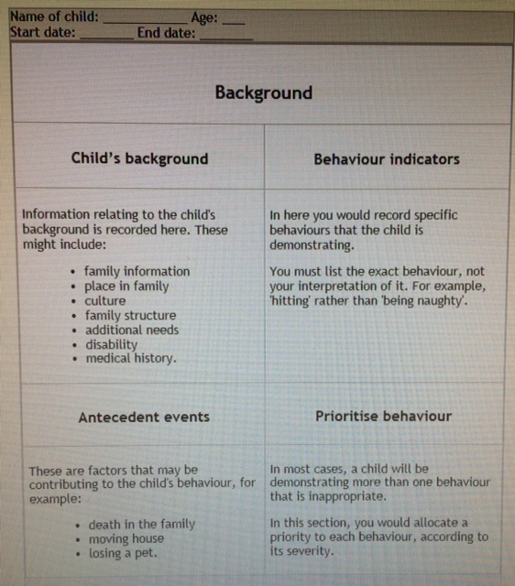
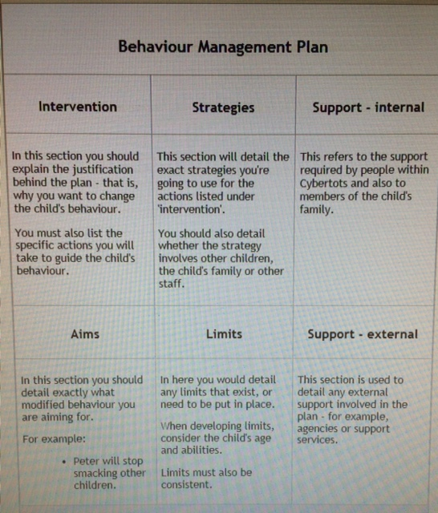
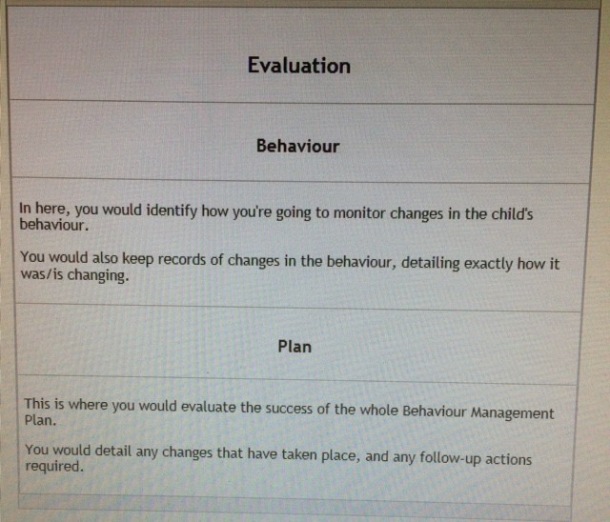
Layout of the plan
The format of a Behaviour Management Plan will change from centre to centre, however they usually cover the same areas.
Below is an example of a plan.

Slide 25
Understanding children’s behaviour enables us to both provide an environment that prevents behavioural concerns and supports children to develop pro-social and considerate behaviours. Building and maintaining strong relationships is a key element that supports us in these endeavours. As such, a positive guidance approach allows the child to enhance and develop a healthy self-esteem, self-control and social awareness and responsibility.
A commitment to ensure that all children feel safe, even when we are presented with challenging behaviours, is fundamental. Parent entrust educators to care and educate their children in a safe and nurturing environments. It is important to remember that children thrive in environments that value them as individuals.

