Slide 1
Health and Safety

Slide 2
Staying healthy -5th edition - Preventing infectious diseases in
early childhood education and care services
Can be downloaded from the internet and is a great resource for you to help Prevent infectious diseases in early childhood education and care services

Slide 3
Infections
Infections are common in children and often lead to illness. At home, children are reasonably well protected from infectious diseases because they do not come into contact with as many people as children who attend education and care services. The adults they meet are usually immune to many childhood illnesses because they had them as children, or have been vaccinated against them. Many children first enter education and care services at a time when their immune systems are still developing. They may not have been exposed to many common germs that cause infections—bacteria, viruses, fungi, protozoa—and they may be too young to be vaccinated against some diseases. The way that children interact in education and care services means that diseases can quickly spread in a variety of ways. Children (particularly younger children) will have close physical contact with other children and carers through regular daily activities and play; they often put objects in their mouths; and they may not always cover their coughs or sneezes.

Slide 4
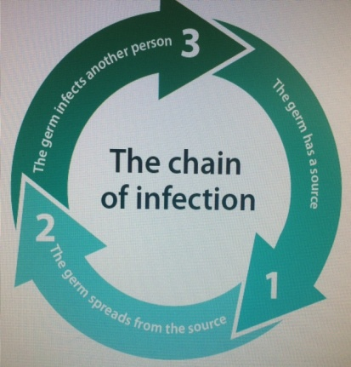
What causes infections?
Microscopic living things (known as germs) are all around us. Some of these germs can cause disease in
people, other animals or plants. There are four major types of germs: bacteria, viruses, fungi and protozoa.
How do infections spread?
This section explains how germs can spread, with a focus on education and care service settings.
The chain of infection
The chain of infection refers to the way in which germs spread (Figure 1.1).
All the steps in the chain need to occur for germs to spread from one person to another. By breaking the chain, you can prevent and control infections. It is important to remember that the chain can be broken at any stage.
3. The germ infects another person
1. The germ has the a source
2. The germ has spreads from the source

Slide 5
Illness and infection are carried through germs. Germs can be spread in three ways.
Direct:
A child with a runny nose hugs and kisses another child who is then infected. There has been direct contact between the infected child and another child.
Indirect:
An infected child touches a toy then puts it down. Another child comes along, picks up the toy and puts it into their mouth. There has been no direct contact between the two children. The illness is passed on indirectly via the toy.
Airborne:
A child is sneezing on one side of the room. From that sneeze microscopic droplets are formed. Those droplets carry germs which hold the infection. They pass through the air and are breathed in by a child on the other side of the room. In this instance an infected child doesn’t even have to have any direct or indirect contact with another child to pass on the illness.

Slide 6
Preventing infection
The most important ways to break the chain of infection and stop the spread of diseases are:
• effective hand hygiene
• exclusion of ill children, educators and other staff
• immunisation.
Other strategies to prevent infection include:
• cough and sneeze etiquette
• appropriate use of gloves
• effective environmental cleaning.

Slide 7
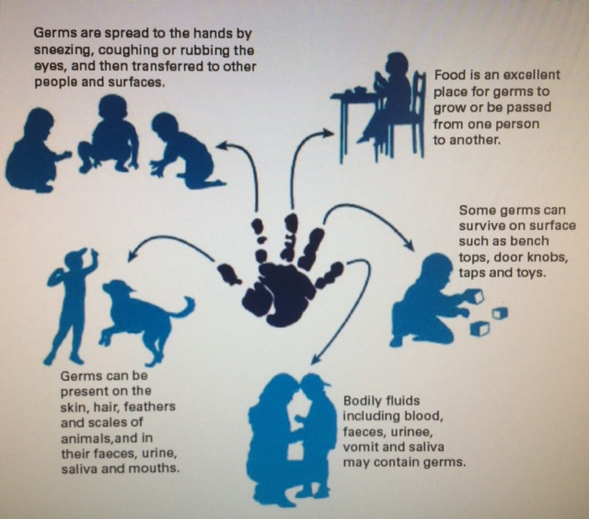
The role of hands in the spread of infection

Slide 8
Effective hand hygiene
Hand hygiene is one very effective way to control the spread of infection. Hand hygiene is a general term that refers to washing hands with soap and water, or using an alcohol based hand rub.
Hands can play an important role in the spread of infection (Figure 1.2). The best way to prevent the transmission of disease is through effective hand hygiene. This can be done with soap and water, which removes both dirt and germs from the hands; or by using an alcohol-based hand rub, which reduces the number of germs on the hands.
Washing hands after wearing gloves
When you have finished a procedure that requires you to wear gloves, it is important to wash your hands thoroughly after removing the gloves, because any germs on your hands may have multiplied significantly while you were wearing the gloves. There may also be microscopic tears or holes in the gloves that can allow germs to contaminate your skin. When taking off the gloves, you may contaminate your hands with the dirty gloves; therefore, it is essential that you wash your hands.
Washing hands before wearing gloves
Wash your hands before putting on gloves so that you remove as many germs as possible from your hands.
Otherwise, when you reach into the box of gloves, you can contaminate the other gloves in the box.
When changing a nappy, it is very important to wash your hands before you put on gloves, so that when you have finished changing the child, you can remove the dirty gloves and dress the child without needing to interrupt the nappy-changing procedure to wash your hands before dressing the child.

Slide 9
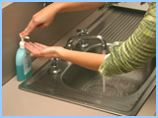
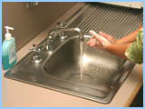
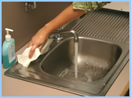
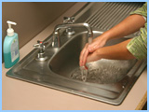
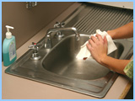
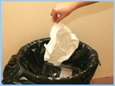
1
2
3
Wet hands
Apply soap
Rub your hands together briskly, including the backs of your hands, between your fingers (don't forget the thumbs!) and around your nails and wrists
5
4
6
Turn off the tap firmly, using a paper towel. Contribute to water savings by ensuring the water flow has completely stopped.
Rinse your hands under the running water for ten seconds.
Dry your hands with a paper towel.
7
Dispose of the paper towel without re-contaminating your clean hands.

Slide 10
Additional strategies
Appropriate use of gloves
Wearing gloves does not replace the need to wash your hands, and you should ensure that you perform hand hygiene before putting gloves on and after taking them off.
Gloves provide a protective barrier against germs. When educators and other staff wear gloves appropriately, they protect both themselves and the children in their care from potential infection. It is important to remember that using gloves correctly will reduce the spread of germs, but will not eliminate it.
PD

Slide 11
Exclusion of ill children, educators and other staff
The aim of exclusion is to reduce the spread of infectious disease. The less contact there is between people who have an infectious disease and people who are at risk of catching the disease, the less chance the disease has of spreading.
Excluding ill children, educators and other staff is an effective way to limit the spread of infection in education and care services.
By excluding one ill person, you can protect many other people from becoming ill
The need for exclusion and the length of time a person is excluded depend on:
• how easily the infection can spread
• how long the person is likely to be infectious
• how severe the disease can be.

Slide 12
Immunisation
Immunisation is a reliable way to prevent some infections. Immunisation works by giving a person a vaccine—often a dead or modified version of the germ—against a particular disease. This makes the person’s immune system respond in a similar way to how it would respond if they actually had the disease, but with less severe symptoms. If the person comes in contact with that germ in the future, their immune system can rapidly respond and prevent the person becoming ill.
Immunisation also protects other people who are not immunised, such as children who are too young to be immunised, or people whose immune systems did not respond to the vaccine. This is because the more people who are immunised against a disease, the lower the chance that a person will ever come into contact with someone who has the disease. The chance of an infection spreading in a community therefore decreases if a large proportion of people are immunised, because the immune people will not become infected and can protect the vulnerable people; this is known as ‘herd immunity’.
HO

Slide 13
Educators should ask all parents to provide a copy of their child’s vaccination records. If the child has a vaccination record, make sure they have received all the vaccinations recommended for their age group.
Non Immunised Children
A child who is not immunised can still be brought into the centre, however they must provide a Dr’s note that stipulates that the parents/ caregivers have chosen to not medically vaccinate their children , this includes children who may have been naturopathically or homeopathically vaccinated, tell the parents that their child will be excluded from care during outbreaks of some infectious diseases (such as measles and pertussis), even if their child is well. use other methods such natural remedies instead on immunisation.
This is because the effectiveness of naturopathic or homeopathic vaccinations has not been scientifically proven.
A statement about excluding non-medically vaccinated children should be included in the education and care service’s immunisation policy.

Slide 14
You can encourage parents to vaccinate their children by:
Putting up wall charts about immunisation in rooms
Reviewing which children are behind in their vaccinations each month, updating the child’s records kept in the education and care service, and sending home a reminder card
Putting a message about immunisation at the bottom of receipts.
When enrolling children, education and care services should make a note of when the child will need updates to their vaccinations. Services should review the vaccination status of all children, educators and other staff every year.

Slide 15
A healthy and safe environment
Disinfectants
Disinfectants are usually only necessary if a surface that has already been cleaned with detergent and water is known to have been contaminated with potentially infectious material. Most germs do not survive for long on clean surfaces when exposed to air and light, and routine cleaning with detergent and water should be enough to reduce germ numbers. Disinfectants might be used after routine cleaning during an outbreak of, for example, a gastrointestinal disease.
Clean first, then disinfect
It is more important to make sure that all surfaces have been cleaned with detergent and warm water than to use a disinfectant. If you do need to use a disinfectant, remember that the disinfectant will not kill germs if the surface has not been cleaned first.
To kill germs, any disinfectant must:
• have enough time in contact with the surface to kill the germs (as per the manufacturer’s instructions)
• be used at the right concentration
• be applied to a clean, dry surface
• be effective against those particular germs.
Note that you should only use bleach for cleaning up small to large blood spills. Bleach is stronger than other disinfectants and can inactivate blood borne viruses.

Slide 16
Watching for and recording symptoms in children
Because we care for the children in a group every day, you are probably used to the way each of them looks and behaves when they are healthy. It is useful for educators and other staff to have some understanding of the signs and symptoms that suggest that a young child may be quite ill and need urgent medical attention. These include the following:
• High fever—a high fever in a young child can be a sign of infection, and needs to be investigated to find the cause. However, fever by itself is not necessarily an indicator of serious illness (see below for more details about fever).
• Drowsiness—the child is less alert than normal, making less eye contact, or less interested in their surroundings.
• Lethargy and decreased activity—the child wants to lie down or be held rather than participate in any activity, even those activities that would normally be of interest.
• Breathing difficulty—this is an important sign. The child may be breathing very quickly or noisily, or be pale or blue around the mouth. The child may be working hard at breathing, with the muscles between the ribs being drawn in with each breath.
• Poor circulation—the child looks very pale, and their hands and feet feel cold or look blue.
• Poor feeding—the child has reduced appetite and drinks much less than usual. This is especially relevant for infants.
• Poor urine output—there are fewer wet nappies than usual; this is especially relevant for infants.
• Red or purple rash—non-specific rashes are common in viral infections; however, red or purple spots that do not turn white if pressed with a finger require urgent medical referral because the child could have meningococcal disease.
• A stiff neck or sensitivity to light—this may indicate meningitis, although it is possible for infants to
have meningitis without these signs.
• Pain—a child may or may not tell you they are in pain. Facial expression is a good indicator of pain in small infants or children who do not talk. General irritability or reduced physical activity may also indicate pain in young children.

Slide 17
What to do if a child seems unwell?
Separate the ill child from the other children. If the child is not well enough to participate in activities, contact their parent and send them home. A child who is feeling unwell needs to be with a person who cares for them—this is usually a parent or grandparent.
While waiting for the parent to arrive, keep the child away from the main group of children, if possible.
For example, they could lie on a floor cushion or mat in a corner of the room where you can still comfort and supervise them. After the child leaves, ensure that the mattress or floor cushion is cleaned before it is used again. Some infectious agents can persist on surfaces and may cause infection even if an object looks clean or is wiped clean.

Slide 18
What to do if a child has a fever?
Key things to remember about fever:
• The normal temperature for a child is up to 38°C.
• Fevers are common in children.
• If the child seems well and is happy, there is no need to treat a fever.
• If the child is less than 3 months old and has a fever above 38 °C, contact the child’s parent and ask them to take the child to a doctor or ask permission to take the child to a doctor yourself.
• If the child is unhappy, treatment is needed to comfort them. Give clear fluids and, if the parents give permission, paracetamol.
• Watch the child and monitor how they are feeling.
Reducing the fever
Warning: Before giving any medication to a child, it is extremely important for educators and other staff to check if the child has any allergies to the medication being administered. Parental consent should be obtained before administering any medication to a child
SC
HO

Slide 19
Hygienic nappy changing and toileting
Faeces (and sometimes urine) contain billions of germs. Hygienic nappy changing and toileting is important
to prevent these germs from spreading disease.
Nappy changing
Parents and education and care services may have different preferences for nappies: some may choose to
use cloth nappies, and some may choose disposable nappies. However, the use of disposable nappies is
strongly encouraged in education and care services. This is because disposable nappies are less likely to
spread germs into the environment15 because they are less prone to ‘leaking’ than cloth nappies and can be
disposed of immediately.
Whether you choose cloth nappies or disposable nappies, it is important to minimise the risk of contact
with urine and faeces when dealing with soiled nappies. This includes keeping soiled nappies in a contained
space, and having a separate, dedicated nappy change area.
An area should be specifically set aside for changing nappies. Ensure that the nappy change mat or surface
is not torn and can be easily cleaned. Do not share the same nappy change mat with children from another
room, if possible. Having separate change mats for each room can help limit the spread of an infection and
contain it to a single room. If this is not possible, take extra care to ensure that the change mat is thoroughly
cleaned after each nappy change, especially if a child is known to have an infection.
Check that all the supplies you need are ready. If the child can walk, walk with them to the changing area.
If the child cannot walk, pick them up and carry them to the changing area. If there are faeces on the child’s
body or clothes, hold the child away from your body if you need to carry them.

Slide 20
Placing paper on the change table
Every time a child has their nappy changed, germs are put on the change table. Placing a piece of paper on the change table catches many of these germs so they do not reach the change table itself. Any paper can be used for this, including paper towel (but this can be expensive), greaseproof paper or large sheets of butcher’s paper or recycled paper. The paper is removed in the middle of the nappy change, before the child’s clean clothes are put on, and the paper and the germs are put in the bin. If an education and care service does not wish to use paper on the change table, extra care must be taken in cleaning the change mat between nappy changes.
Wearing disposable gloves
Disposable gloves should always be worn on both hands when changing nappies, to prevent the spread of germs in faeces and urine. Wear gloves only during the part of the nappy changing process when you may come in contact with faeces or urine. Once the child is clean and the paper has been removed from the change table, remove your gloves so you will not touch the clean child with dirty gloves.

Slide 21
Cleaning the child
Pre-moistened disposable wipes are recommended to clean the child.
Cleaning the change table
Try to have at least two nappy change surfaces for each day as an additional way to prevent the spread
of disease. A waterproof sheet over the change mat can be the morning surface; this can be removed for
the afternoon.
Toilet training
Ask parents to supply a clean change of clothing for children who are toilet training. Place soiled clothes in
a plastic bag or alternative, and keep these bags in a designated place until parents can take them home.
Help the child use the toilet. It is better for the child to use the toilet rather than a potty chair, which
increases the risk of spreading disease. If the child must use a potty, empty the contents into the toilet and
wash the chair with detergent and warm water. Do not wash the potty in a sink used for washing hands.
Children, especially girls, should be encouraged to wipe front to back, to reduce the chance of introducing
bowel bacteria to the urinary tract.
After toileting, help the child wash their hands. Ask older children if they washed their hands. Explain to
the child that washing their hands and drying them properly will stop germs that might make them ill.
Always wash your own hands after helping children use the toilet.

Slide 22
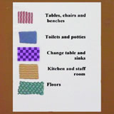
Cleaning the environment
Using paper towel is the best way to clean up as you are throwing the germs straight into the bin however not very sustainable.
Cleaning with Cloths
Different cloths should be used for each duty.
For example, pink cloths might be used for cleaning tables, and green cloths for cleaning floors. This helps to stop the spread of germs and bacteria from one surface to another. Your child care service will have their own procedure to follow.

Slide 23
Safely dealing with spills
Accidental spills of body fluids—including blood, vomit, urine, faeces and nasal discharge—are a fact of life within education and care services. Prompt management of spots and spills, including removing the spilled substance, and cleaning and disinfecting the area, reduces the potential risk to children, educators and other staff in education and care services.
Prevention is better than cure. Strategies to prevent spills of body fluids include:
• regularly toileting children
• using disposable nappies rather than cloth nappies
• excluding children with vomiting or diarrhoea
• making sure children play safely.

Slide 24
Blood
Children must be supervised at all times, and it is important to ensure that they play safely. If a child is bleeding, through either an injury, bites from other children or a nosebleed, you need to:
• look after the child
• allow the first-aid officer to dress the wound (if appropriate)
• check that no-one else has come in contact with the blood
• clean up the blood.
Looking after the child
• Avoid contact with the blood.
• Comfort the child and move them to safety, away from other children.
• Put on gloves, if available.- If gloves are not available, take the first opportunity to get someone wearing gloves to take over from you. Then wash your hands.
• Apply pressure to the bleeding area with a bandage or paper towel.
• Elevate the bleeding area, unless you suspect a broken bone.
Send for the first-aid officer (if appropriate).
• When the wound is covered and no longer bleeding, remove your gloves, put them in a plastic bag or alternative, seal the bag and place it in the rubbish bin.
Wash your hands thoroughly with soap and running water (preferably warm water).

Slide 25
Faeces, vomit and urine
When cleaning up spills of faeces, vomit or urine, the following procedures should be used:
• Wear gloves.
• Place paper towel over the spill and allow the spill to soak in.
Carefully remove the paper towel and any solid matter. Place it in a plastic bag or alternative, seal the bag and put it in the rubbish bin.
• Clean the surface with warm water and detergent, and allow to dry.
• If the spill came from a person who is known or suspected to have an infectious disease (e.g. Diarrhoea or vomit from a child with gastroenteritis), use a disinfectant on the surface after cleaning it with detergent and warm water.
• Wash hands thoroughly with soap and running water (preferably warm water).
Nasal discharge
Washing your hands every time you wipe a child’s nose will reduce the spread of colds. If you cannot wash your hands after every nose wipe, use an alcohol-based hand rub.
It is not necessary to wear gloves when wiping a child’s nose. If you do wear gloves, you must remove your gloves and wash your hands or use an alcohol-based hand rub afterwards.
Dispose of dirty tissues immediately.

Slide 26
A safe environment
Did you know?
Accidental injury is the leading cause of death for children.
Children have the right to be safe wherever they are – at home, at school and at their child care service. Safety in a child care centre starts with the environment. This includes the buildings, the outdoor areas and all the equipment within these areas.
It is the responsibility of all staff and management at a child care centre to provide and maintain a safe environment, and to encourage children to act safely within it. Each child care centre will have its own policies and procedures to help its staff achieve this, as well as following relevant state or territory regulations.

Slide 27
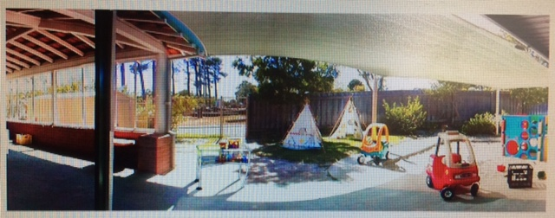
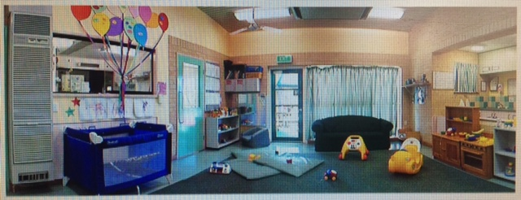
There are five hazards identified in this photo of the outdoor play area for the 2-3 year olds. Think about why it is a risk or hazard for this age group, how can we reduce each risk?

Slide 28
Now it’s time to have a look inside. This is the indoor area for the 0-2 year olds. There are five hazards to think about in this photo too.

Slide 29
Other potential hazards
Attention needs to be paid to the following potential hazards.
Electrical – cords, adaptors and power boards need to be out of children’s risk. Unused power points must have protective caps.
Water – all children require supervision around water to prevent drowning. Spills need to be mopped up immediately. Hot water requires a regulator to prevent scalds. A cup of tea can burn a child.
Surfaces – the floor or ground can present a tripping hazard if they are not level.
Plastic - bags or wrappings can cause suffocation.
Chemicals - such as cleaning products pose a risk of adverse reaction, burns or even poisoning.
Sun exposure – it doesn’t take much sun for a young child’s skin to burn. Children are also much more susceptible to dehydration so plenty of water to drink is essential. Check out the Sun care policy in the Cybertots Intranet for more info on this.
Animals- insects, snakes, spiders, dogs, swooping magpies.
Environment – gas leaks, water leaks, fire, storms, earthquakes.
Human – aggressive children, aggressive or intoxicated parents, intruders.
HO

Slide 30
Medication A child may need to be given medication whilst in Childcare . There is no room for error in handling and administering medications, so the centre has a policy for staff to follow.
Administering Medication:
Parents should be instructed to deliver any medication to a staff member so that it can be stored securely and at the recommended temperature.
Medication must not be left in a child's bag where it could be accessed.
Staff should ensure the medication is administered at the right time and in the right amount at the prescribed intervals.
All medication should be checked by two staff members before it is administered to ensure the correct child is being given the medication.
The medication record form should be signed by the staff member who administered the medication and the staff member who cross checked that the correct medication and dose was given to the correct person at the designated time.

Slide 31
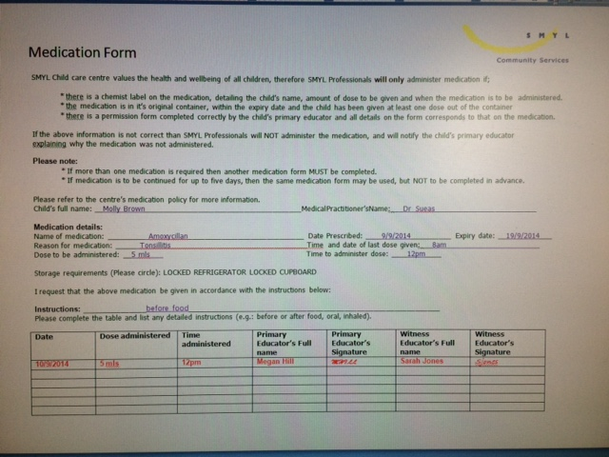
Medication example
HO

Slide 32
Keeping children and staff safe in the sun
Australia has the highest incidence on skin cancer in the world and over exposure to the sun in childhood is known to be a major cause of skin cancer in later life. With summer upon us, now is an excellent time to review your centre's sun protection policies. Child care providers are required to have a sun protection policy and to meet sun protection requirements to satisfy the licensing and accreditation standards set by the NCAC. The SunSmart Early Childhood Program was set up by the state based Cancer Councils to help child care providers devise and implement sun safe policies. The program can also help child care providers bring out-of-date sun protection policies up-to-date with current recommendations. The SunSmart Program was designed for all child care providers including family day carers, long day care centres, occasional care centres, preschools, work based services and mobile services and hundreds of providers across the country have already signed up. According to the Cancer Council a sun protection policy should clearly outline a service's policies and procedures with regard to protecting children and staff at the centre from UV radiation including: Minimising outdoor play during peak UV periods.
Using shade for outdoor play
Use of sun safe hats and protective clothing
Use of sun screen
Education about sun protection
Role modelling so staff are a positive influence on children
As with all policy and procedure documents a sun protection policy should be written in straightforward language and made available for parents and visitors to the centre to review.

Slide 33
The Cancer Council identifies the five main ways to protect children
and staff from the effects of the sun as follows:
1. Minimise the time spent outdoors during peak UV periods.
From October to March outdoor activity should be minimised between 11am and 3pm and protective clothing, hat and sunscreen should be used at all times when staff and children are outside.
From April to September outdoor activity can take place at any time during the day and protective clothing, hats and sunscreen are required between 10am and 2pm except in June and July when UV radiation tends to be lower.
2. Use shade for outdoor play Staying in the shade is one of the most effective ways to reduce sun exposure because it blocks or filters UV rays. However, shade doesn't guarantee total protection so hats, protective clothing and sunscreen should still be used.
3. Use the right hat Well designed hats with broad brims which extend right the way around can significantly reduce UV exposure to the face, neck, ears and head. SunSmart recommended hats for children include: Broad-brimmed hats with a brim size of at least 6cm
Bucket style hats with a brim size of at least 5cm and a deep crown
Legionnaire hats
Recommended hats for adults are: Broad-brimmed hats with a brim size of at least 7.5cm
Bucket style hats with a brim size of at least 6cm and a deep crown
Legionnaire hats
Baseball caps and sun visors are not recommended as they don't protect the neck, ears and cheeks.

Slide 34
4. Wear protective clothing Clothing reduces the skin's exposure to UV radiation by creating a barrier to the skin. For the best UV protection staff and children in child care centres should cover as much skin as possible, especially the shoulders and back. Recommended clothes include: loose fitting shirts or dresses with collars and sleeves, trousers, long skirts and shorts.
5. Apply SPF30+ broad spectrum sun screen before going outside Sunscreen protects exposed skin and should be applied 20 minutes before staff and children go outside and every two hours after the first application. Centres should use a sunscreen that: Has a sun protection factor of 30+, this is the highest available in Australia.
Is water resistant and broad spectrum. Broad spectrum sun screens block out both UVA and UVB rays both of which contribute to sunburn, premature skin aging and cancer.
Sunscreens do not block 100 per cent of UV rays and should be used in conjunction with clothing, hats, sunglasses and shade

Slide 35
WHS
WHS Stands for Workers health and Safety
When thinking of this title we need to be aware of the following defintions
Duty of care: A common law concept that refers to the responsibilities of organisations to provide people with an adequate level of protection against harm and all reasonable foreseeable risk of injury. In the context of this policy, duty of care refers to the responsibility of education and care services to provide children, staff, students, volunteers, contractors and anyone visiting the service with an adequate level of care and protection against reasonable foreseeable harm and injury.
Hazard: An element with the potential to cause death, injury, illness or disease.
Hazard identification: A process that involves identifying all foreseeable hazards in the workplace and understanding the possible harm that each hazard may cause.
Hazard management: A structured process of hazard identification, risk assessment and control, aimed at providing safe and healthy conditions for employees, contractors and visitors while on the premises
Harm: Includes death, or injury, illness (physical or psychological) or disease that may be suffered by a person as a consequence of exposure to a hazard.

Slide 36
Material safety data sheet: Provides employees and emergency personnel with safety procedures for working with toxic or dangerous materials. The data sheet includes all relevant information about the material such as physical properties (e.g. melting/boiling point, toxicity and reactivity), health effects, first aid requirements and safe handling procedures (e.g. personal protective equipment, safe storage/disposal and management of spills).
Risk: The chance (likelihood) that a hazard will cause harm to individuals.
Risk assessment: A process for developing knowledge/understanding about hazards and risks so that sound decisions can be made about the control of hazards. Risk assessments assist in determining:
what levels of harm can occur
how harm can occur
the likelihood that harm will occur.
Risk control: A measure, work process or system that eliminates an OHS hazard or risk, or if this is not possible, reduces the risk so far as is reasonably practicable.

Slide 37
Everyone involved in an early childhood education and care service has a role to play in ensuring the service’s operations are safe and without risk to the health and safety of all parties. In W.A, health and safety in the workplace is governed by a system of laws, regulations and compliance codes that set out the responsibilities of employers and employees to ensure safety is maintained at work.
The legal duties of an employer under the WHS Act are:
to provide and maintain a workplace that is safe and without risk to the health of employees.
to ensure other individuals, such as families and visitors, are not exposed to health and safety risks arising from the organisation’s activities
to consult with employees about WHS matters that will, or will likely, affect employees directly, including identifying hazards and assessing risks, and making decisions about risk control measures.
The WHS Act places the responsibility on employees for:
taking care of their own safety and the safety of others who may be affected by their actions
co-operating with reasonable WHS actions taken by the employer, including following guidelines, attending WHS-related training, reporting incidents, co-operating with WHS investigations, encouraging good WHS practice with fellow employees and others at the service, and assisting the employer with conducting WHS inspections during operating hours
not interfering with safety equipment provided at the service, such as fire extinguishers.

Slide 38
The Work Health and Safety Officer is responsible for:
ensuring that all educators/staff are aware of this policy, and are supported to implement it at the service
ensuring that all equipment and materials used at the service meet relevant safety standards
ensuring the service is up to date with current legislation on child restraints in vehicles if transporting children
implementing and practising emergency and evacuation procedures
implementing and reviewing this policy in consultation with the management team and all staff, contractors and parents/guardians
identifying and providing appropriate resources and training to assist educators, staff, contractors, visitors, volunteers and students to implement this policy
keeping up to date and complying with any relevant changes in legislation and practices in relation to this policy.

Slide 39
Manual handling overview
Manual Handling occurs when any person, animal or object is lifted or lowered, pushed or pulled, carried, moved, held, or restrained. Employers have a Duty of Care towards their employees. This means employers and employees are responsible for creating and maintain a safe work environment.
Educators manual handling tasks include;
assisting with fruit/lunch
adjusting client sitting postures
assisting a child to walk
assisting with toileting
transferring child from floor
other duties
assisting child onto play equipment
Injuries arising from Manual Handling
50% of all claims are Muscular Skeletal Disorders – MSDs. These include:
muscle and joint injury to any part of body
muscular and joint pain
impact injuries
physical tiredness.

Slide 40
Back injuries can be very serious – in fact, they're the most common injury reported in the workplace. In a child care centre, you are often required to lift things, so it is important that you are aware of the correct lifting procedures to use so that you protect yourself against back injury
If a staff member is hurt while caring for children, another staff member must immediately step in to supervise, as the children should never be left alone.
Safety signs
There are many different systems and supports in use in workplaces all over Australia to help workers stay safe at work. One such system is having standardised safety signs to alert workers to:
the presence of hazards and dangerous goods
the availability of and requirement to wear personal protective equipment and
the locations and use of emergency equipment.

Slide 41
Risk assessment
Risk is the probability and possible consequence of injury and illness arising from exposure to a hazard.
Risk assessment involves an assessment of the level of risk of injury or illness associated with each of the identified hazards. A hazard is any situation with the potential to cause illness or injury.
Risk Assessment takes into account the following five factors.
postures adopted
movements made
forces exerted
environmental conditions
duration and frequency.
It also considers:
How severe would the injuries be?
What is the probability of injury?

Slide 42
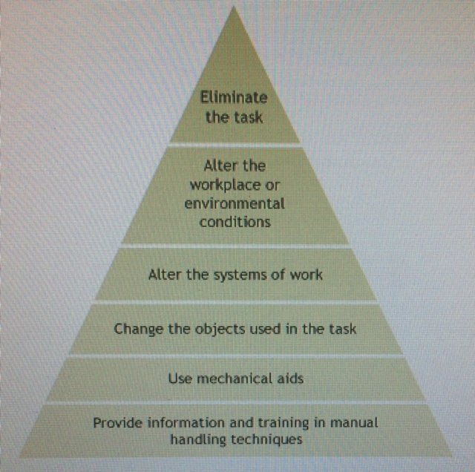
Hierarchy of control
The Hierarchy of Control is a list of control measures, in order of priority, which can be used to eliminate or minimise exposure to the hazard.

Slide 43
Correct manual handling principles
1. Assess the task
The safest way and the best technique for performing the task is determined by considering:
the environment
the ability of the handler to perform the task eg size, age, state of health
the nature of the load - ie animate or inanimate.
When lifting or transferring a child with a disability, it is essential that there should be communication before the procedure to ensure the dignity of the child and the safety of both the child and the staff member. The mode of transfer must be discussed and the child involved in the planning and implementation of the procedure.
2. Plan
Ensure that the area is free from obstacles, which may interfere with the smooth implementation of the procedure eg bags, other children, or tables.
Wear comfortable clothing, which allows free movement. Shoes should have flat heels, covered toes and provide good support to the feet. Articles of jewellery, which could become entangled, should be removed. Brakes must be applied to moveable equipment.
Ensure adequate help is available.
3. Position the feet
Feet should be comfortably apart to provide a wide base of support and to allow the handler to get as close to the load as possible.
Feet should be positioned in the direction of movement of the procedure so that weight can be transferred smoothly from one leg to the other. The centre of gravity should fall within the base of support to give a more stable posture.

Slide 44
4. Take a secure grip
Make sure that the grip is comfortable for both the child and the handler and that this is decided before commencing a procedure.
5. Keep the load close to the body
Make sure the load is brought as close as possible to the handler to minimise stress on the lumbar spine.
6. Maintain good posture throughout the procedure
The vertebral column should be in correct alignment in the normal spinal curvature. The handler should keep his/her head up and neck straight, brace abdominal muscles to support his/her spine and avoid twisting.
7. Use the leg muscles
Hips and knees must be bent to lower the centre of gravity and align the body correctly. The strong leg muscles are used to reduce the stress on the spine.
8. Use body momentum
Timing is essential so that the transfers can be performed smoothly and steadily. Both client and handler should be fully prepared and the timing agreed eg one, two, three - lift.
In team lifting, one person becomes the leader and directs the procedure.

Slide 45
Coping with stress
What kinds of things can cause you stress? There are many things such as children, people, traffic, money, environment, debt, illness, time, family and responsibility.
You might be interested to know that:
Work related stress accounted for 3.5 percent of injuries to males and 2.1 percent of injuries to women in the health and community services industry.
In a recent audit of Queensland child care centres, 'mental stress' accounted for 4% of injuries to child care workers.
Stress can be caused by many factors in the workplace, the main issue (in recent research) being noise levels in the centre.
Considering that stress is such a major issue in this industry, the following are important:
Take your rest times and breaks as and when they're allocated. There's a good reason why you are given 'time out' - you will need it! Always take the time to sit back and relax, to clear your mind and rest your body.
Let your supervisor know if you are feeling stressed by events or issues at work. Remember, the problem can't be resolved unless someone knows about it. Your supervisor will treat your concerns with respect and confidentiality.
Be clear on what your job responsibilities are. Don't perform duties for which you are not trained, and focus firstly on your own duties and areas of responsibility before helping others
If you feel that non-work related issues or events are causing you to lose focus at work and you feel stressed, address the problem You may like to speak to your supervisor about the way you're feeling, or seek counselling. Many people find it helpful to talk to a close friend or family member as a way of trying to deal with their stress.

Slide 46
Safety checklist
With younger children, ensure that equipment or materials are large enough to prevent them getting caught in the child's throat if they place them in their mouth.
Babies in particular place objects in their mouth as part of their natural exploration of materials and their learning. A good rule of thumb is if an object can fit into a small 35 mm film container, then it is too small for young children (under 4 years) to be exposed to.
The height of the climbing equipment is another consideration, particularly with young children. Although the younger child may be able to climb to great heights, they may not have the developmental skills to move around at that height and then climb down again. The adult needs to stand close to the child and assist if they observe the child having difficulty.
All climbing equipment needs to be placed on a soft-fall area such as 20 cm of tan bark, rubberised surfaces or mats inside, to soften the impact if a child falls from the piece of equipment.
Grass, artificial grass and sand may hide a very compacted surface that can cause injury and damage to the child if they fall.
Regularly sweep away sand that has come out of the sandpit. After mopping floors, make sure the surface is dry before children and staff walk on it. These are very important safety considerations for all staff who work with children.
Before allowing children to play outdoors, a staff member needs to check the outside play spaces for any syringes, used condoms, or bottles or cans, and dispose of these appropriately.

Slide 47
Emergency situations
A sudden event or situation that requires an immediate response can be really scary. In emergencies people can panic or feel confused. The best way to make sure emergency situations are handled as well as possible is to plan, prepare and practise for them.
In a child care centre, the adults have to be able to ensure their own safety and that of the children in their care. While older children may be able to follow verbal instructions and remove themselves from the danger, babies and toddlers will obviously need a much higher level of support from staff. All child care centres must have a comprehensive and well-practised plan in place to deal with emergencies. As a child care worker you will need to be very familiar with the emergency plans in your workplace.
Try the Evacuation activity below and see if you can beat the clock. You'll need to read the Evacuation Procedure first to know what to do, just like in real life.

Slide 48
Follow these steps in the case of fire:
Locate the source of the fire. Where is it?
Locate any people. Shout out! Check all store rooms, kitchen area and toilets.
Remove all people from the building Try to keep calm. Get everyone out
Once outside do a head count. Make sure everyone is safe.
Notify the authorities. Ring 000 for the Fire Service.
If you hear the evacuate mode of the fire alarm or when instructed to evacuate by the fire warden:
Walk quietly but quickly to the nearest exit and proceed to the assembly point outside the building to await further instructions.
Listen and follow instructions from the fire wardens.
In order to prevent injury and possible panic during evacuation it is important to do the following:
do not run, push, or overtake
use stairs - do not use lifts
do not return to your area of work
do not return to the building until the fire warden or fire service gives the 'all clear'.

Slide 49
Risk Management
Children must be supported to feel secure and safe in the education and care environment so that they can safely explore and learn about their world. In order to protect children from harm and any hazard likely to cause injury, the education and care service must manage risks and implement procedures to maintain a safe environment for children, educators and families.
GOALS - What are we going to do?
The education and care service will implement procedures to prioritise the maintenance of environments and conditions that are safe for children, families and educators. Procedures will be implemented to assist with early detection of potential hazards and to reduce risks within the education and care community. The education and care service complies with legislations and regulations and annually reviews policy and procedure to ensure effective risk management practice.

Slide 50
STRATEGIES - How will it be done?
The Approved Provider will:
• Consult with families and educators to establish a Workplace Health and Safety committee/ officer to oversee all risk management procedures.
Educators will:
•Complete daily WHS checklists of the environment before children and families enter the education and care service. Educators will identify any potential hazards and note these on the checklist, rectifying any risks immediately where possible. Any identified hazards that cannot be immediately removed or rectified must be reported to the nominated supervisor immediately.
•Not put themselves or others at risk at any time when seeking to reduce or remove potential hazards.
•Be encouraged to complete first aid training and professional development to increase their awareness of risk management.
•Implement emergency evacuation/lockdown procedures to ensure the welfare of children, families and educators.

Slide 51
References:
Australian Children’s Education and Care Quality Authority 2011, Guide to the National Quality Standard, ACECQA, Canberra, viewed 28 March 2012, <http://acecqa.gov.au/storage/3%20-%20Guide%20to%20 the%20National%20Quality%20Standard%20FINAL.pdf>.
Food Standards Australia New Zealand 2007, ‘Food safety standard 3.2.2: Food safety practices and general requirements’, in Food safety standards, FSANZ, Canberra.
Frith, J, Kambouris, N and O’Grady, O 2003, Health and safety in children’s centres: model policies and practices, 2nd edn, University of New South Wales, Sydney.
Grampians Region Infection Control Group 2010, Environmental services: a little yellow infection control book, Victorian Department of Health, Melbourne.
Heymann, D (ed.) 2008, Control of communicable diseases manual, American Public Health Association, Washington, DC. Middlesex London Health Unit, Alcohol-based hand rubs: questions and answers, viewed 26 July 2011, <www.healthunit.com/article.aspx?ID=12684>.
National Health and Medical Research Council 2003, Dietary guidelines for children and adolescents inAustralia incorporating the infant feeding guidelines for health workers, NHMRC, Canberra.
National Health and Medical Research Council 2009, The Australian immunisation handbook, 9th edn,
NHMRC, Canberra.
Oberklaid, F 2004, ‘Recognising serious illness in young children’, Childcare and Children’s Health, vol. 70, no. 1,v iewed 11 October 2011, <www.rch.org.au/emplibrary/ecconnections/CCCHVol7No1Feb2004.pdf>.
Queensland Health 2008, Infection control guidelines for animal contact, Queensland Health, Brisbane. Queensland Health 2010, Storing breastmilk, Queensland Government, Brisbane, viewed 26 May 2011, <www.health.qld.gov.au/breastfeeding/about_breastfeeding/storing.asp>.
Rego, A and Roley, L 1999, ‘In-use barrier integrity of gloves: latex and nitrile superior to vinyl’, American Journal of Infection Control, vol. 27, no. 5, pp. 405–10.
Royal Children’s Hospital Melbourne 2008, Febrile convulsions, viewed 16 March 2012, <www.rch.org.au/kidsinfo/factsheets.cfm?doc_id=3722>.
Appendix 2 – Key documents and references National Health and Medical Research Council 188 Royal Children’s Hospital Melbourne 2011, Fever in children, viewed 11 October 2011, <www.rch.org.au/kidsinfo/factsheets.cfm?doc_id=5200>.
Stigall, R 2010, Reye’s syndrome, viewed 20 March 2012, <www.kidspot.com.au/familyhealth/Conditions-&- Disorders-Brain-&-nervous-system-Reyes syndrome+2389+208+article.htm%20>.
Van, R, Wun, C-C, Morrow, AL and Pickering, LK 1991, ‘The effect of diaper type and overclothing on fecal contamination in day-care centers’, Journal of the American Medical Association, vol. 265, no. 14, pp. 1840–4.
Women’s and Children’s Health Network 2010, Parenting and child health: fever, viewed 20 March 2012,<www.cyh.com/HealthTopics/HealthTopicDetails.aspx?p=114&np=304&id=1798>.
Community Child Care Co-operative (NSW).
http://www.ectarc.com.au/cybertots/index.htm

