Slide 1
NQS / NQF and ACECQA

Slide 2
The National Quality Standard
The National Quality Standard (NQS) is a key aspect of the NQF and sets a national benchmark for early childhood education and care, and outside school hours care services in Australia.
As the NQF progresses, every service in the country will be assessed to make sure it meets the new quality standard. In the meantime, as safety is paramount all day and every day, every service must comply with rigorous health and safety requirements.
To ensure children enjoy the best possible conditions in their early educational and developmental years, the NQS promotes continuous improvement in quality.
The major benefits for parents and children include:
improved educator to child ratios
greater individual care and attention for children
educators with increased skills and qualifications
better support for children’s learning and development
a national register to help parents assess the quality of education and care services in their area.

Slide 3
The National Quality Standard is linked to national learning frameworks that recognise children learn from birth. It outlines practices that support and promote children’s learning. These are:
Belonging, Being and Becoming: The Early Years Learning Framework for Australia (‘Early Years Learning Framework’)
My Time, Our Place: Framework for School Age Care in Australia (‘Framework for School Age Care’)

Slide 4
The NQS introduces ratings for children's education and care services. The ratings cover Australian long day care, family day care, outside school hours care and some preschools/kindergartens.
Each service receives a rating for: seven quality areas, and an overall rating.
There are five rating levels within the national quality rating and assessment process:
Excellent rating – awarded by ACECQA
Exceeding National Quality Standard
Meeting National Quality Standard
Working Towards National Quality Standard
Significant Improvement Required

Slide 5
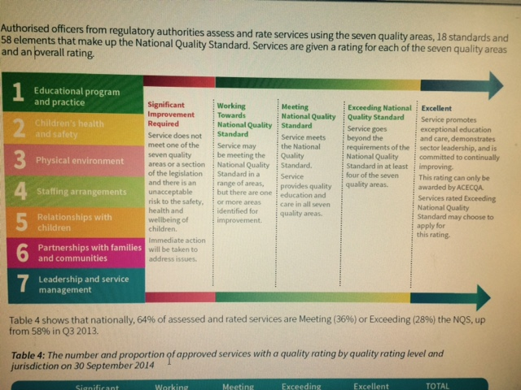

Slide 6
Quality Areas
The National Quality Standard (NQS) is a key aspect of the NQF. The NQS consists of seven quality areas, each containing standards and elements, that children's education and care services are assessed and rated against.
The seven quality areas covered by the National Quality Standard are:
Educational program and practice
Children’s health and safety
Physical environment
Staffing arrangements
Relationships with children
Collaborative partnerships with families and communities
Leadership and service management
Quality Area 1 - Educational program and practice
Watch:
https://www.youtube.com/watch?v=-uBGFrmSg1c&x-yt-ts=1422579428&x-yt-cl=85114404&feature=player_embedded
The Quality Area Educational program and practice requires education and care services to have an educational program that meets children’s individual learning and development needs.
The knowledge, ideas, culture, abilities and interests of your child should be incorporated into the program, with continuous assessment of your child’s learning and development

Slide 7
Quality Area 2 - Children’s health and safety
Watch:
https://www.youtube.com/watch?x-yt-ts=1422579428&v=zg5JUcr-VJA&x-ytcl=85114404&feature=player_embedded
The Quality Area Children’s health and safety focuses on supporting and promoting children’s health and safety while attending education and care services. You should expect your child’s service to have policies and procedures in place on healthy eating, children’s safety, dealing with any injury or illness, and preventing harm to children.
Quality Area 3 - Physical environment
Watch:
https://www.youtube.com/watch?x-yt-ts=1422579428&v=QyyxcfRTL8o&x-yt-cl=85114404&feature=player_embedded
The Quality Area Physical environment focuses on the physical environment at an education and care service. The environment must be safe, suitable and provide a rich and diverse range of experiences promoting children’s learning and development. –

Slide 8
Quality Area 4 - Staffing arrangements
Watch:https://www.youtube.com/watch?x-yt-ts=1422579428&v=KZKHt8NhdsY&x-yt-cl=85114404&feature=player_embedded
The Quality Area Staffing arrangements requires services to ensure they are meeting adequate staffing arrangements as required under the National Quality Framework. This means the provision of qualified and experienced staff who are able to develop warm, respectful relationships with children, create safe and predictable environments and encourage children’s active engagement in the learning program.
Quality Area 5 - Relationships with children
Watch: https://www.youtube.com/watch?x-yt-ts=1422579428&v=iXKkMZC2DII&x-yt cl=85114404&feature=player_embedded
The Quality Area Relationships with children is about building relationships with children at education and care services that are responsive and respectful and promote children’s sense of security and belonging. These relationships allow children to freely explore their environment and engage in play and learning.
Quality Area 6 - Collaborative partnerships with families and communities
Watch: https://www.youtube.com/watch?v=EvgkGPlAb9M&x-yt-ts=1422579428&x-yt-cl=85114404&feature=player_embedded
The Quality Area Collaborative partnerships with families and communities encourages the development of collaborative partnerships with families and communities. These relationships are fundamental to achieving quality outcomes for children and require active communication, consultation and collaboration.

Slide 9
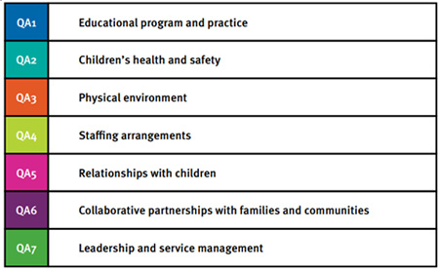
Quality Area 7 - Leadership and service management
Watch: https://www.youtube.com/watch?v=3tC3Kh1uweE&x-yt-ts=1422579428&feature=player_embedded&x-yt-cl=85114404
The Quality Area Leadership and service management focuses on effective leadership and service management. It is important to ensure quality environments for children’s learning and development are a priority. Good service leadership and management should have well-documented policies, procedures and records, shared values, clear direction, and reflective practices to enable the service to function as a learning community. An ongoing cycle of planning and review, including engagement with families, creates the climate for continuous quality improvement.

Slide 10
Australian Children's Education and Care Quality Authority
ACECQA is an independent national authority, based in Sydney. It is led by CEO Karen Curtis and guided by a 12 member governing Board whose members were nominated by each state and territory and the Commonwealth. Board members serve three year terms.
As the name suggests, one of ACECQA’s many roles is to educate and inform the wider community about the importance of improving outcomes in children’s education and care. We also provide governments, the sector and families with access to the most current research to ensure NQF policy and service delivery is in line with best practice across the country.
ACECQA guides the implementation of the National Quality Framework for Early Childhood Education and Care nationally and ensures consistency in delivery.
What is the role of ACECQA and regulatory authorities –
https://www.youtube.com/watch?xytcl=85114404&v=RJUE1mJ_dOY&feature=player_embedded&x-yt-ts=1422579428

Slide 11
Western Australia Regulatory Unit is
Department of Local Government and Communities, Education and Care Regulatory Unit
Level 1, 111 Wellington Street, East Perth, WA 6004
Website: www.digc.wa.gov.au
Email: ecru@digc.wa.gov.au
Phone: (08) 6551 8333
Fax (09) 65521555
Assessment and Ratings Process
The following tables outline the national quality rating and assessment process for evaluation of services against the National Quality Standards and the National Regulations. It is designed to be a cooperative process with opportunities for services to discuss how they are meeting the National Quality Standards and enhancing outcomes for children. The timeframes reflect the approximate period of time involved in each step.

Slide 12
Timeline | Step | Process
Week 1* | A: Notice of visit | The approved provider receives a letter from the regulatory authority notifying of the four week period in which the assessment and rating visit will occur. The regulatory authority requests that the approved provider submits a copy of the service Quality Improvement Plan within three weeks. The regulatory authority may also request additional service specific information.
Week 3 | B: Quality Improvement Plan | The approved provider submits the Quality Improvement Plan to the regulatory authority.
Weeks 5 - 8 | C: Visit occurs | The assessment visit will occur during the four week period specified in the letter to the approved provider. The regulatory authority will give the approved provider at least five days’ notice of the date of the visit. The authorised officer may give some general comments at the time of the visit but will not give an indication of the service rating. Feedback may include the opportunity to make minor adjustments to the service operation within specified areas and timeframes to address concerns identified at the visit. For further information on the minor adjustments policy refer to the Guide to Assessment and Rating for Regulatory Authorities.
After the visit
Approx. 3 - 5 weeks after the visit date | D: Draft report | The approved provider is issued the draft report. The approved provider has 10 working days to provide feedback on any factual inaccuracies in the report and provide evidence to support their feedback.
Approx. 5 - 7 weeks after the visit date | E: Feedback due | Feedback on the draft report is provided to the regulatory authority. If no feedback is provided, the report is final and the notice of final ratings is issued to the approved provider.
Approx. 8 weeks after the visit date | F: Final report | If feedback is provided on the draft report, this is considered by the regulatory authority, the report is then finalised and the notice of final ratings is issued to the approved provider.

Slide 13
NQF
National Law and Regulations
National Law
The National Quality Framework (NQF) operates under an applied law system, comprising the Education and Care Services National Law and the Education and Care Services National Regulations. The NQF applies to most long day care, family day care, outside school hours care and preschools/kindergartens in Australia.
Education and Care Services National Law (WA) Act 2012
National Regulations
The NQF and associated regulatory system is enacted through legislation establishing the national system. The Education and Care Services National Regulations support the legislation and provide detail on a range of operational requirements for an education and care service.
Education and Care Services National Regulations

Slide 14
A handy tip .....
NQS relates to the 7 Quality Areas
NQF relates to the Regulations and Act
ACECQA is all of the above

