Slide 1
Nutrition and Safe Food handling

Slide 2
In this section we explore the nutritional food and drink requirements of the infants and children in our care to ensure their health, safety and wellbeing.
There is a lot we need to know and a lot we can do to achieve this. First we need to be aware of good organisation and planning practises for the safe handling and preparation of food for a well balanced diet. Then we need to know how we can meet the individual needs of a child considering their age, special dietary needs, cultural and or religious requirements.
When planning meals and drinks we have rules and regulations to follow.
Some of the rules and regulations she needs to follow are:
The National Food Safety Guidelines
Australian Dietary guidelines
Infant Feeding Guidelines
Dietary Guidelines for children and adolescents.

Slide 3
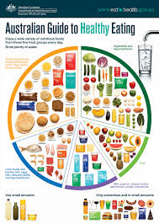
A balanced diet will mean that you are receiving all the nutrition you need - enough carbohydrates, iron, energy, protein, fat, fibre magnesium, water, zinc, thiamin, riboflavin, niacin, folate, sodium, vitamin C, potassium, calcium, vitamin A and vitamin B12.

Slide 4
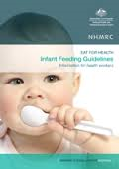
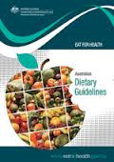
Guidelines
The Infant Feeding Guidelines are aimed at health workers to assist them in providing consistent advice to the general public about breastfeeding and infant feeding. They support optimum infant nutrition by providing a review of the
evidence, and clear evidence-based recommendations on infant feeding for health workers.
By following the dietary patterns recommended in the Guidelines and the Australian Guide to Healthy Eating, we will get enough of the nutrients essential for good health and also help reduce our risk of chronic health problems such as heart disease, type 2 diabetes, some cancers and obesity. We may also feel better, look better, enjoy life more and live longer!

Slide 5
Guideline 1: To achieve and maintain a healthy weight, be physically active and choose amounts of nutritious food and drinks to meet your energy needs Children and adolescents should eat sufficient nutritious foods to grow and develop normally. They should be physically active every day and their growth should be checked regularly. Older people should eat nutritious foods and keep physically active to help maintain muscle strength and a healthy weight.
What do different levels of physical activity mean?
Sedentary activities mainly involve sitting or lying down, using little energy.
Light activities include standing and moving around in the home, workplace or community.
Moderate activities require some effort but you can still have a conversation. For example, walking briskly, gentle swimming or social tennis.
Vigorous activities make you huff and puff, so talking is difficult. Vigorous activities include jogging, aerobics and sports like football and netball.

Slide 6
GUIDELINE 2: enjoy a wide variety of nutritious foods FROM THESE FIVE GROUPS EVERY DAY
Plenty of vegetables, of different types and colours, and legumes/beans
Fruit Grain (cereal) foods, mostly wholegrain, and/or high cereal fibre varieties such as breads, cereals, rice, pasta, noodles, polenta, couscous, oats, quinoa and barley
Lean meats and poultry, fish, eggs, tofu, nuts and seeds, and legumes/beans
Milk, yoghurt, cheese and/or their alternatives, mostly reduced fat
And drink plenty of water.

Slide 7
Minimum recommended number of serves of vegetables per day

Slide 8
Minimum recommended number of serves of fruit per day

Slide 9
Minimum recommended number of serves of grain (cereal) foods
per day, mostly wholegrain and/or high cereal fibre varieties

Slide 10
Minimum recommended number of serves of lean meats and poultry, fish, eggs, tofu, nuts and seeds, and legumes/beans per day

Slide 11
Minimum recommended number of serves of milk, yoghurt, cheese and/or alternatives per day, mostly reduced fat

Slide 12
Australian tap water is an ideal drink – it’s inexpensive, tastes good and is safe in most areas of the country. Fluoridated tap water helps develop strong bones and teeth.
Choose water instead of drinks with added sugars or alcohol. The amount of water we need varies depending on individual factors including diet, climate and levels of physical activity.
Tea and coffee provide water, although they are not suitable for young children and large quantities can have unwanted stimulant effects in some people.
Consumption of drinks with added sugars, such as soft drinks and cordials, fruit drinks, vitamin waters, energy and sports drinks can increase risk of excessive weight gain in both
children and adults.
Water has an advantage over these drinks, and also over fruit juice and artificially sweetened soft drinks, because it has no kilojoules and a low acidity – acidity can erode the enamel of the teeth.
Soft drinks may also increase the risk of dental caries and may have a negative impact on
the strength of our bones.

Slide 13
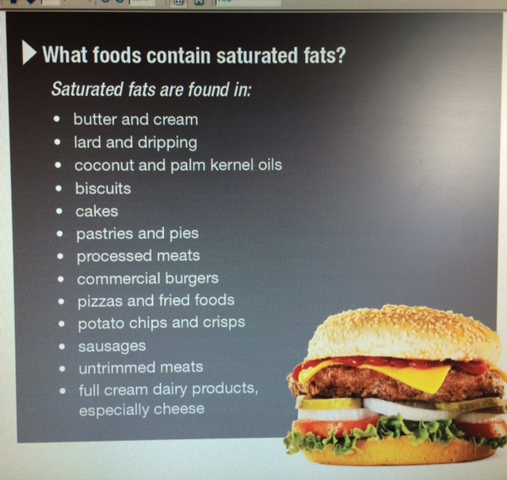
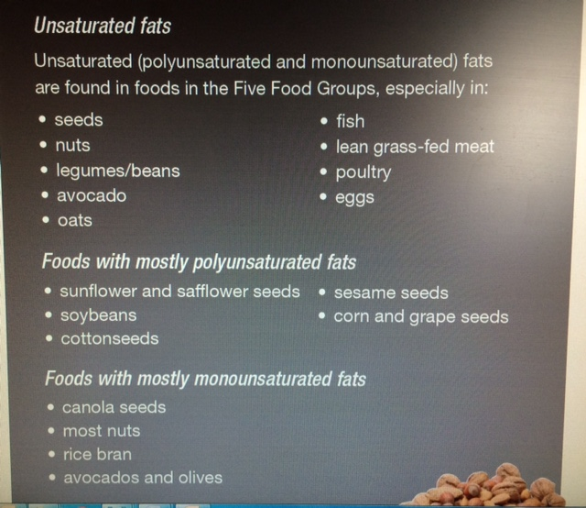
GUIDELINE 3: LIMIT INTAKE OF FOODS containing SATURATED fats, added salt, added sugars

Slide 14
GUIDELINE 4: Encourage, Support and promote BREASTFEEDING
Breastmilk is the ideal food for infant growth and development. Breastfeeding
provides many benefits for mothers as well as infants, both now and into the future.
It is recommended that infants are exclusively breastfed for around the first six months of life. This means that they are given breastmilk and nothing else during this time. Breastfeeding provides all the nutrients and fluids a baby needs. Breastfeeding should continue until the baby is 12 months old, or for as long as both the mother and infant want to keep going.
But any breastfeeding is beneficial to the infant and mother. By around six months of age, solid foods such as iron-fortified infant cereals, puréed meats, tofu and legumes followed by vegetables, fruits and other nutritious foods can be introduced to the baby. Introduce different tastes and textures as the baby grows. By 12 months of age, infants should be consuming a wide variety of nutritious foods enjoyed by the rest of the family.

Slide 15
GUIDELINE 5: CARE FOR YOUR FOOD; PREPARE AND
STORE IT SAFELY
We have a reliable, safe and nutritious food supply in Australia. But food poisoning happens too frequently.
All foods, and particularly fresh foods, need to be transported, stored and prepared properly to avoid contamination. This is particularly important when we are preparing food to eat later.
Food poisoning occurs when we eat contaminated foods or drinks. Contamination can occur when foods aren’t kept at the right temperature, when raw foods aren’t separated from cooked and ready to eat foods, when food preparation tools aren’t cleaned properly or the people preparing foods are unwell and don’t follow good personal hygiene practices.
Fresh or perishable foods are especially at risk of contamination. We can get the best from

Slide 16
Child care providers and parents know how quickly illness can spread among the children in a center. Food is a common way for illness to spread. Workers who have recently been ill can unknowingly contaminate the foods prepared and served to children. Contaminated food products brought into the kitchen can also be the cause of an outbreak.
Usually we think of food safety as a summertime concern, but foodborne illness can occur any time of the year. Food contaminated with harmful bacteria and viruses that cause illness spread quickly among children as they share toys, food, toilet facilities, mats, and come in contact with other articles handled by children who are sick or have recently been sick.
Food products can be mishandled anywhere along the food production chain and contamination with harmful microorganisms can occur. Because microorganisms (organisms too small to be seen by the unaided eye) cannot be seen, all food products must be handled carefully. Some microorganisms cause food to spoil-smell and look bad. When food smells bad, we get the message and do not eat it. Unfortunately, many of the microorganisms (pathogens) that cause food borne illness do not alter the smell or the appearance of food.
In childcare facilities, food safety is everyone's responsibility, not just the food service staff. Remember that the teachers and other personnel often come in contact with the food served to the children and should be familiar with safe food handling practices.

Slide 17
Choosing and storing food
• If buying packaged food, check its ‘best-before’ or ‘use-by’ date.
• Use an esky, insulated bag or box with an ice pack if you need to travel more than half an hour home or if it’s hot outside. Store your food at home as soon as you can.
• Chill foods in the fridge to slow growth of micro-organisms. Keep cool foods cool and frozen foods frozen.
• Keep fridges at or below 5°C and the freezer between -15° and -18°C.
• Keep your fridge and freezers clean. And get rid of those old shrivelled vegetables, ‘left-overs’ or frozen foods lurking in the corners for too long!
• Store foods away from cleaning agents and insecticides.
• If you are not going to eat cooked dishes and foods straight away, put them in the fridge as soon as you can.

Slide 18
PREPARE FOODS SAFELY
• Wash your hands before touching food, and after going to the toilet, touching animals, changing nappies or blowing your nose. Use soap and warm running water and dry your hands on a clean towel.
• Wash fruit and vegetables thoroughly with clean water before you eat or prepare them.
• Keep your food preparation areas clean, particularly the surfaces, cutting boards and any bowls and utensils used.
• Don’t allow raw foods, like eggs, meat, chicken or seafood, to be in contact with cooked or ready-to-eat foods. Keep cutting boards and serving plates separate.
• Foods, particularly poultry and meats, need to be cooked thoroughly, and at the right temperature.
• Avoid preparing foods if you are sick. Put a band aid on any cuts or sores.
Keep fingernails trimmed and clean. Scrub nails with a nail brush after a visit to the toilet and after handling raw meat, poultry, and fish.
Keep hair clean and use a hairnet or other restraint.

Slide 19
The time & temperature of potentially hazardous foods must be controlled through the entire production process, from receipt to serving to the children:
Receive potentially hazardous food at 5°C or below or 60°C or above, unless the temperature and the time taken to transport it will not adversely affect the safety of the food (3.2.2 c5).
Check that fridges are operating effectively at 5°C or below and heating/hot holding equipment is operating effectively at 60°C or above.
Cook potentially hazardous food thoroughly to above 75°C

Slide 20
Personal hygiene
Good personal hygiene is essential to ensure that:
food is not contaminated with food-poisoning bacteria or other matter such as foreign objects or chemicals
hands and other parts of the body do not transfer food-poisoning bacteria to food.
Personal hygiene practices include:
hand washing - always wash hands thoroughly with soap and warm water
before handling food and after visiting the toilet
coughing or sneezing
handling garbage
touching hair or other body parts or any other activity that may carry bacteria to food
Personal cleanliness - when handling food:
tie long hair back or cover it with a cap or other approved headwear
wear limited jewellery
wear clean protective clothing over normal clothing
store personal items and spare clothes away from any areas involving food handling
Personal behaviour - do not smoke, chew gum or undertake any other unhygienic practice in food handling areas
Illness and injuries - all wounds or cuts on hands or arms are to be completely covered with brightly coloured wound strip or bandage. If the wound is on the hands, disposable gloves must be worn over the top of the wound strip. Both the wound strip and gloves must be changed at least hourly or sooner if there is a change in tasks. Individuals suffering from diseases that can be transmitted through food must not handle food.

Slide 21
Avoid cross contamination
Keep raw and cooked or ready to eat foods separate by:
cleaning and sanitising utensils, surfaces and equipment between preparing raw and cooked foods or use separate equipment, storing raw foods below cooked foods.
Clean and sanitise utensils, equipment and surfaces per the cleaning schedule
Use equipment and containers that can be easily and effectively cleaned, will not absorb grease, food or water and will not contaminate the food;
Cover food with plastic wrap or place in a container with a lid; and
Store food off the floor.
Store chemicals where they cannot contaminate food and according to the manufacturer’s instruction.

Slide 22
Planning a Menu
All children will have different tastes, differing appetites, and a different willingness to try new foods, and these may change over time. Daily and weekly menu planning can help ensure that children receive adequate nutrients everyday
Individual needs are determined by the age and state of the child and also by their preferences. Parents can be helpful here as they often have the best ideas about what their children like and dislike. Some young children can be fussy eaters too! But it is important that meal times are relaxed and enjoyable. Always offer new foods for children to try and encourage them to taste unfamiliar food too.
Religious requirements might also influence the type of foods that Nola provides the children and will also influence the type of food experiences that you plan. There may be some children whose parents only want them to eat vegetarian food, and some families whose religious beliefs may influence what they eat. This information is usually discussed with the centre at enrolment and orientation.
Religious reasons are not the only thing that can influence diet, but cultural preferences can also be a factor. It is important to take into account cultural influences when planning menus for the children.Even if your service doesn’t have families from different backgrounds it still is important to have food from different cultures. This allows children to appreciate diversity, respect difference and try new foods.

Slide 23
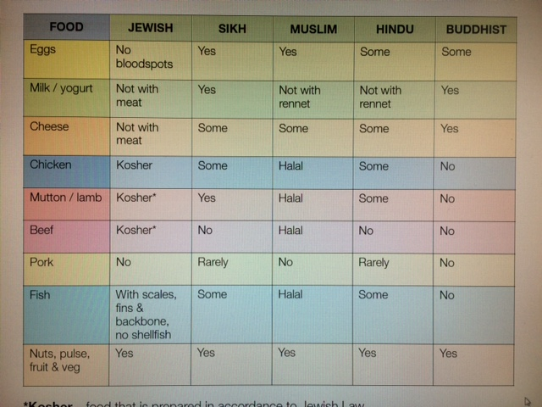
*Kosher – food that is prepared in accordance to Jewish Law.
*Halal – food and preparation methods permitted under Islamic Law.

Slide 24
Nutrients children need at different ages and stages of their development
Individual children’s special dietary needs and preferences cultural factors attractive ways to serve food that looks appealing to children Australian Dietary Guidelines (2013)
Infant Feeding Guidelines (2012)
Sometimes you will need to educate and support families by providing them with information about healthy eating.
Your centre's food and nutrition policy will be available for parents to read in your handbook. This will be a good starting point. You can also make sure that your menus are displayed in a prominent area for families to see. You can share popular recipes with parents and ask for recipes from them that might be included in some of your menus.
The children can be involved in learning about healthy eating and share their investigation with their parents. Posters in the foyer can be displayed and even guest speakers can be arranged to talk to parents about nutrition.

Slide 25
Days of the week
Full description of what the meal will contain
Presentation
 | Monday | Tuesday | Wednesday | Thursday | Friday
Morning tea | Wholemeal Toast and variety of spreads –Jam, cheese spreads, vegemite,honey | Grilled cheese on baguettes | Fruit smoothies with strawberry yoghurt | Muesli Cereal and milk | Multigrain toast with assorted spreads Jam, cheese spreads, vegemite,honey
Lunch | Grilled lamb cutlets Mashed sweet potato Carrots Corn Crumble | Tuna frittata Greek salad lettuce tamoto. Mountain bread | Potato and Leek soup Wholemeal rolls Jelly with fruit salad apple, watermelon, grapes | Beef and noodle stir fry with broccoli Bagels Apple slices | Roast chicken pasta Garden salad- lettuce, tomato Banana and sultanas
Afternoon tea | Fruit kebabs | Melon balls | Ham and cheese sandwiches | Fruit and date muffins with wholemeal flour | Assorted sandwiches variety of bread and fillings Jam, cheese spreads,vegemite,honey ham, chicken, palony
Late afternoon | Crisp breads and cheese | Crackers with vegemite and cream cheese | Apples and sultanas | Cheese sticks and dried fruit | Fruit platter
Drinks | Water or milk offered at every meal and water available throughout the day and easily accessed by children.
All meals provided for the day
Drinks that will be provided

Slide 26
The menu can be made very interesting if children join in...
Allowing children to make decisions on Lunch will not only get ideas of children's interests but promote discussion on healthy eating
pineapple
Chicken
Ham
What should we have on our Pizza
Cheese
Tomato sauce
sausage
Jot down the discussion and attach it to your menu as evidence

Slide 27
Promoting Healthy Eating as an educator
Firstly: As an educator you need to understand the importance of nutrition
Good nutrition is essential for:
• growth and physical development
• healthy brain functioning
• prevention of illness
• repair of cells / recovery from illness
• good concentration
• maintaining energy
• overall wellbeing
In education and care services, there are many opportunities to help children:
• learn healthy eating habits and behaviours;
• make healthy food and lifestyle choices;
• feel good about themselves and care for their body; and
• enjoy physical activity through play.
To promote healthy eating and good nutrition for children, it is important to think about how you can do this across different areas of provision. For example, you might have a healthy eating policy stating that all children will be given healthy food options but that may be as far as it goes. Children are more likely to achieve the outcomes (listed above) if you embed them into all aspects of service delivery. Such as philosophy, staff practices, policies and procedures, the curriculum and your work with families. In order to do this a ‘whole team’ approach is required. The entire staff team need to be consistent in their practices in supporting children’s healthy eating habits and good nutrition.

Slide 28
When promoting healthy eating and nutrition in your service, some things to consider include:
Legal requirements
Understanding the legal obligations for your service under the NQF (including national law, regulations, NQS and learning frameworks).
Policies and procedures
Your healthy eating policy and other relevant policies need to be up to date and in line with current needs of children and legal requirements.
Healthy food choices Food offered to children in the service must be adequate in nutritional value
and in keeping with the recommended quantities for their age, size, activity
level and dietary needs as per recommended dietary guidelines. Foods coming from child’s own home must be healthy also.
Discuss amongst educators what intentional teaching strategies (for
example, demonstration and role modelling) could be adopted to further
encourage children to make healthy food choices for themselves.

Slide 29
Partnership with families
Ensure that all families know about what and how your service promotes
healthy eating and good nutrition for children. Share relevant information,
policies and procedures at enrolment.
Equity
Foods offered to children should be reflective of their cultural,
religious beliefs and specific dietary requirements.
Curriculum
Think about ways to engage children in planned and unplanned play experiences, conversations and routines that could promote healthy eating and good nutrition.
Environment of the service
Mealtime environments need to be set up in a way which is inviting to
children.
Remember the potential learning which could take place during mealtimes
so take time to set it up like any other activity.

Slide 30
Food safety
Food safety practice must be in line with current regulatory requirements
and all staff must adhere to food safety measures.
Ensure that your Food Safety Plan is up to date (and aligned with your
State / Territory / council requirements). Your plan should always reflect
your actual practices.
Staff practices
All educators need to understand the healthy eating (and related) policies
and procedures.
Eating habits and attitudes to foods greatly influence the children so ensure
all educators are working from the same philosophy which values children’s
health as part of their overall wellbeing and development.
Identify any training needs of staff, for example, food handling, food
storage or menu planning. (See your local PSC for a full list of Professional
Development).

Slide 31
Environment – physical and social
Tables - ensure the tables are visually appealing to children. Add flowers, candles
and tea lights (battery operated), tablecloths, soft music and lighting. (Ask the
children what you could do to make your current mealtime environment better).
Equipment - Cutlery and utensils must be manageable for all children and
respectful of cultural differences and religious ways of eating food. Plates,
bowls - is everything plastic? If so, why have you made this choice? Use real
items as often as possible (think about EYLF and FSAC principle of having high
expectations of children). Jugs and glasses must be a suitable size and assist with
children’s self-help skills.
Indoor space - If children eat indoors then consider the colours of the walls and
the displays. What atmosphere is created as a result? It is essential to create a
warm, inviting atmosphere so children will enjoy eating in that space. This can
be achieved by adding natural lighting (where possible), good ventilation, soft
furnishings and a happy, relaxed atmosphere. The physical design and colour of
the room influences the way in which children act in that space.
ü Outdoor space – if children are eating outdoors then similarly it needs to in a
relaxed, pleasant space where time and effort has gone into setting up the tables
and equipment appropriately.

Slide 32
Social environment – during mealtimes:
Independence and self-help skills – encourage children’s self-help skills by
encouraging them to choose the amount of food they want to eat. This will foster
their self-regulation skills also. Offer facilities that will allow children to easily clean up after meals.
Interactions and relationships – use mealtimes with children as an opportunity to
promote NQS QA 5 (Relationships with children). For example, 5.1.2 states that
‘every child is able to engage with educators in meaningful, open interactions that support the acquisition of skills for life and learning.’ (The Guide to the National Quality Standard, 2011)
Bonding with babies - This is particularly important for babies and younger children where so much of the learning occurs around their daily routine, like feeding time.
Babies need to feel safe and secure and connected to the person feeding them so
ensure the same educator per feed for babies with minimal interruptions.
Communication - Allow time for children to communicate with each other through
facial expressions, talking, watching and socialising with each other.

Slide 33
Food Labels
Food labels and nutritional information panels: what and where they are
Food labels are included on all food products, except for very small packets and fresh foods, such as fruit and vegetables and local bakery or organic products.
Food labels tell you what ingredients or additives are in the food. They give you nutritional information about the food’s fat and protein content. And they tell you who manufactured the food.
Nutritional information panels are a part of the food label. These tell you what nutrients the food contains and how much of each nutrient there is.
When you buy a packaged food product, have a look at the back of the packet. You should be able to see a box with a heading like ‘Nutritional information’. Under the heading, you’ll see categories like:
serving size, energy, protein, fat, carbohydrates, dietary fibre, sodium

Slide 34
Nutritional informational panels
All foods have to list seven nutrients on their nutritional information panels – energy (kilojoules), protein, total fat, saturated fat, total carbohydrates, sugars and sodium. Manufacturers might decide to include other nutrients too.
Comparing the nutritional information on different food products helps you work out the healthiest choice. All you need to do is see which one has lower saturated fat, lower sodium, lower sugar and higher fibre.
When you’re comparing two products, look at the ‘per 100 gm’ information on each, rather than the ‘per serving’ information. This way you can compare the same thing on each product.
‘Use by’ and ‘Best before’ dates
All foods with a shelf life of less than two years must have a date on them that tells you when the manufacturer advises the food will either be unsafe to eat or not as good to eat:
Use by is for perishable foods such as meat, fish and dairy. This is the date that tells us when a food is ‘off’. It’s illegal for shops to sell food past its ‘Use by’ date.
Best before tells you the date when the food will still be safe to eat but might not be of the best quality anymore.
Baked on or packed on is the date the food was manufactured or packed. This tells you how fresh it is. You might see this on foods like bread and meat.

Slide 35
