Slide 1
Routines for Babies

Slide 2
Sleep patterns and routines
Newborn babies can take 6 to 10 weeks or even longer to develop a regular sleep pattern.
Sleep routines
When preparing babies and toddlers for sleep, it can be helpful to follow a routine that lets them know it is nearly time to go to sleep.
Selecting an area for sleep will help establish a routine. Try to make the room relaxing and inviting, so the children feel comfortable and able to go to sleep easily keep the room well ventilated and at a comfortable temperature.
This lets them know it is time for sleep gives the children quiet time before sleep. Reads or tells them a story so they can relax and feel calm make the room darker and play soft, relaxing music making sure you understand some children are different in the way they like to go to sleep.

Slide 3
A baby's upbringing and culture will determine how important sleep routines are. As you can imagine in Africa amongst the Nomads some of our recommended strategies for sleep may be very inappropriate! Nomad children may fall asleep in many different locations or in their mother's arms or a sling as the mother moves around.
All babies have their own individual sleep times and routine depending upon the child-rearing practices of the family, eg sleeping in a hammock, in mother's arms, carried in a baby sling, pram, indoors/outdoors, etc.
It is important to communicate with the child's family and provide care that closely approximates care at home as this will provide consistency and security for the child.
This is why communication with the child's family is so important. Discuss with the child's parents or family members what the child's individual routine is and how you can follow it to minimise disruption for the child

Slide 4
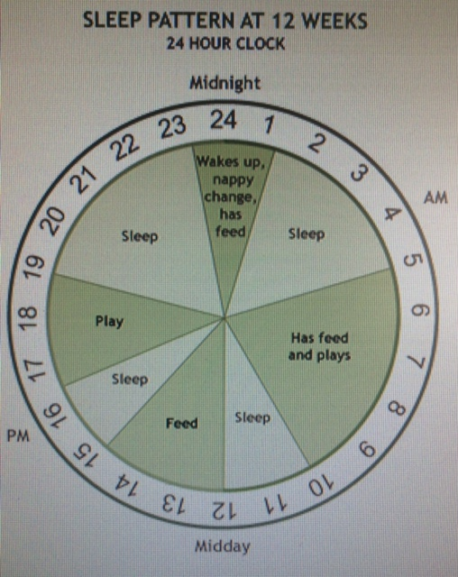
Sleep patterns - babies
Do you know how much sleep babies need? While this will vary between individuals, a major factor is their age. It may take a baby some time to develop a regular sleep pattern.
Newborn babies
Newborn babies don't have regular sleep patterns. They usually take up to 6 to 10 weeks to develop some type of pattern. Some take longer. Newborn babies may sleep for between 12 and 20 hours a day. They usually need between 4 and 6 sleep periods in 24 hours, and one of those rest periods will be between 5 and 7 hours.
3 months
Around 3 months of age babies may begin to sleep through the night, although many continue to wake once or twice during the night.
Here is an example of a 3 month old's sleep pattern. They usually sleep between 12 and 14 hours a day.

Slide 5
6 months
By 6 months of age, babies have usually developed a predictable sleeping pattern. Babies in this age group usually sleep for around 12 to 16 hours out of every 24 hours.
8 months
By 8 months of age, a high percentage of babies sleep through the night and only require 2 or 3 naps a day.
12 months
By 12 months of age, babies are often down to only one day time nap of 1 to 3 hours, and a night time sleep of approximately 12 to 14 hours.

Slide 6
Sudden Infant Death Syndrome (SIDS)
Sudden Infant Death Syndrome (SIDS) is a very important issue to be aware of and to actively try to prevent.
Sudden Infant Death Syndrome (SIDS) is the term used when a baby dies unexpectedly and for no obvious reason. These deaths are devastating but can’t be predicted. You can, however, take precautions against SIDS.
Contributing factors SIDS is generally more common in winter, in colder climates, in families from lower socioeconomic groups, and in babies who have been born very prematurely. It usually happens between the ages of 1-6 months, and is rare after children turn one.
The onset of the fatal episode in SIDS is thought to occur during sleep. There’s usually no sign that anything was wrong with the baby, and no sign during the night that the baby was upset or unwell. Sometimes the baby might have had a very mild cold in the days before the death.
SIDS affects about 1 in every 3000 infants. SIDS deaths have fallen significantly in the past few years all around the world.

Slide 7
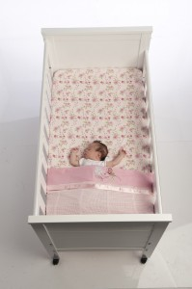
Prevention
Although we don’t know what causes SIDS, research over recent years has shown some strong links between SIDS and several risk factors. Paying attention to these risk factors might reduce the risk of SIDS. In fact, the publicity that these risk factors have received has helped reduce cases of SIDS all around the world.
Keep the baby cool Your baby will get too hot if he’s covered with too many blankets. If your baby has a cold or a fever, he needs even fewer blankets. Don’t put soft pillows, cushions and bumpers in the cot because they restrict the flow of fresh air around your baby’s head, and might increase the temperature. Make sure the room isn’t overheated.
Wrap your baby so her head and arms move freely. Avoid putting hats or bonnets on her while she’s sleeping, because head coverings increase body temperature.
Avoid stuffed toys in the cot Comforters, fluffy blankets and stuffed toys in the cot can increase your baby’s temperature or lead to suffocation.
Sleeping environment It’s recommended that your baby sleep in her own cot next to your bed for the first 6-12 months of her life. Put the baby in the cot with her feet at the bottom of the cot, so that she can’t move down in her sleep. This will stop her face getting covered with blankets.
Sleeping position There’s now very strong evidence that babies put to sleep on their stomach are at increased risk for SIDS. Always put your baby to sleep on his back.

Slide 8
Responding to distressed babies
Did you know?
Babies who are not cuddled and cared for, may feel rejected and be unable to form secure attachments with their educators.
When a baby is crying, it can be upsetting to hear or might make you feel worried or irritated. Remember that babies don't cry to irritate you or because they are being 'naughty' - they always cry for a reason.
As an educator, you need to respond quickly to a crying baby in a calm and relaxed manner. You should provide physical comfort by holding or cuddling the baby while you work out what their needs are.
When babies wake up
When babies wake up, it's important to respond to them in an unrushed and sensitive way. They need to wake up at their own pace.
It is important to leave babies sleeping until they naturally wake up. If a baby in your care wakes and starts to cry, you need to attend to his/her needs.
This could mean picking the baby up if they need a feed or nappy change, or patting the baby back to sleep. In each case this reassures the baby that you are there for them

Slide 9
Why your response is important
It is important to respond quickly, yet in a relaxed manner, to distressed babies. When a child is crying loudly and demanding that you help them right now, it is easy to realise they need your attention. It is also important to remember that all babies need care and attention - not just when they're crying.
A child's first few years are vitally important to their development, both mentally and physically. Babies need lots of love, care and cuddles. These are important in letting the child know that they are cared for, loved and valued.
Babies who are not cuddled and cared for, may feel rejected and be unable to form secure attachments with their caregivers. They may also fail to develop positive self-esteem and have difficulties forming attachments with others in later life.
Babies have to form a concept of self, and this is dependent upon being cared for in a way that communicates to the baby that he/she is valuable, worthwhile and loveable. This is a vital foundation for establishing emotional and psychological wellbeing both immediately and in later life.

Slide 10
Recognising signs of distress
Did you know?
Asking family members can be a good starting point in recognising what a baby is trying to communicate.
Cues and cries
Did you know that babies use cues to communicate with us? Cues are signs or signals that babies use to communicate their needs, feelings or interests. They might gesture, point, vocalise, or use facial expressions.
Parents and family members are a good way of finding out more about a baby's cues and cries. They spend a lot of time caring for their child and get to recognise what the child is trying to communicate.
Some other ways you can get to know a baby's cues are by:
playing and interacting with them
observing them in different situations
participating in their daily routines
talking to other caregivers who have cared for them
taking note of their efforts to communicate, and what they mean.

Slide 11
What do you think is the most common cue that babies use to communicate?
Crying! Newborn babies can spend about 6 to 7 per cent of their day crying. All babies are different, some may cry frequently and others only occasionally.
Remember, babies don't cry to annoy or irritate you! They cry to let you know that they need something. It's just their way of communicating.
Speaking to people who have children is a great way to find out about crying and how to deal with it. The more people you speak to the more you will learn!
Each child is an individual, so you will find people's experiences can be quite different. You may find that children within the same family are quite different in the way they communicate and how much they cry.
There are many ways that babies and toddlers show distress. As a caregiver, you will learn to recognise these signs. Lets take a look at some now....

Slide 12
Signs of distress
Babies | Toddlers
crying - high pitch whimpering grizzling squirming appearing withdrawn difficulty sleeping/feeding lack of eye contact clinging to adults wanting to be held. | a change in eating behaviour - eating more/less/using fingers a change in physical behaviours - throwing toys/throwing self on the floor, biting, pushing, hitting, kicking, screaming, yelling clinging to an adult wanting to be held not exploring the environment tugging at clothing not playing or not playing creatively repetitive replaying of trauma difficulty sleeping speech difficulties (such as stuttering) toilet training difficulties nervous tics (such as coughing) excessive masturbation throwing toys regression of self-help skills: in toilet training o in language o in all behaviour

Slide 13
Reasons for Distress
Physiological state | Environment (physical) | Physical discomfort | Emotional state
tired hungry thirsty too hot - internal temperature too cold - internal temperature unwell out of routine. | crowded - in close proximity to others loud noises room temperature outdoor temperature strangers loss of attached person Unpleasant. | wet/soiled pain bored lonely unpleasant physical contact. | angry pleased afraid excited frustrated relaxed anxious bored sad happy.

Slide 14
Anxiety can often be a cause of distress for young children. At around 8 months of age, children often become anxious, clingy and easily frightened by unfamiliar people. This is known as stranger anxiety.
Separation anxiety occurs when a baby or child is separated from a family member or caregiver. This anxiety can often occur when a child is dropped off at day care and their family member leaves for work. Children and babies begin to learn that when their family members leave the room, they will not be back soon.
When they show anxious behaviour, it means that they want to stay close to the person to whom they are attached. Babies often struggle between wanting to be independent and wanting to stay close to their parents or educator.

Slide 15
Feeding
First 6 months
For the first 6 months, all a baby drinks is milk. The milk may be breast milk or infant formula. If the day is really hot, and the child is perspiring, you may need to offer more than the usual amount of breast or bottle feed.
Breast milk may be expressed by the mother using a pump or the mother may be close enough to be able to come to the child care centre and feed the baby. A quiet, comfortable and private place, if the mother wishes, should be available for breastfeeding. Expressed breast milk stored in bottles can be labelled and given to the child later
As an educator you will find that individual children have individual needs. The feeds required by the infant can range from 4 to 7 feeds a day, some of which will occur while you are caring for them.
6 and 8 months of age
Between 6 and 8 months of age, the infant will begin to eat solids. What they eat and when they begin will vary between individual children and will depend on how their bodies react and what their needs are.
Usually the first food introduced to an infant is rice cereal. This is least likely to cause an allergic reaction or any other problems. A variety food is gradually introduced so that the baby's reactions can be noted.
Infants will still consume breast or formula milk, but the amount of milk that they drink will start to decrease as they begin to eat more solids.

Slide 16
8 and 12 months
Between 8 and 12 months the amount of breast milk or formula milk may be further reduced, and may not be wanted as often by the child.
At this age, they are starting to eat more solid food.
They will still need milk, but not as much as they did during the first 6 months of their life.
12 and 24 months
At this age, food preferences start to develop. The child may become a fussy eater or not eat as much. Usually, children will eat what and when they need.
During this period, children learn to feed themselves. This means they need lots of opportunities to explore and handle a variety of foods and utensils, even though this will be messy. Educatosr need to support the child's learning by giving them plenty of opportunity to practise. Educators also need to model for children the ways in which we eat. This may mean eating with the children. Children need lots of practice, support and carer patience while they gain the skills to use cutlery and cups.
Some babies are fed formula milk. Parents may choose formula so they can share the feeding role. There are many other reasons people choose either breast or formula milk. It is a personal choice for the family and educators should be careful not to judge them and their choice.
Formula milk is made to closely resemble breast milk. There are many different varieties available. You should keep up to date with new formulas that become available.
When preparing formula, you must read the instructions very carefully and follow them exactly. It is important to make up the formula correctly according to the directions

Slide 17
Bottle feeding
Feeding a baby can be a very special time. It is an opportunity to build on your relationship with the baby and spend some one-on-one time. As an educator, this may not always be possible, as you have other children to care for. You will need to learn the skill of nursing the baby while communicating with the other children at the same time.
Have a look at the procedure for bottle feeding below.
Before you begin feeding you need to make sure that both you and the baby are clean and ready to relax while feeding.
Wash and dry your hands thoroughly.
Make sure that the baby is clean and comfortable. It is best for them to have a clean nappy if needed. Changing the baby’s nappy and cleaning their face and hands also means that the baby is prepared for bed if they happen to nod off to sleep during feeding.
Before you give the baby their bottle, shake the bottle to make sure that all the milk is at a constant heat. Test the temperature of the milk to make sure it is not too hot or cold by squirting some milk onto your wrist
Keep the bottle at an appropriate angle during feeding so that the teat of the bottle is always full of milk, to prevent the baby drinking in air bubbles. Have breaks during feeding if the baby needs it. Halfway through feeding, change the side that you are feeding on.
Only feed a baby until they have had enough. Never force feed the baby. They have small stomachs and will only eat until they are full.

Slide 18
Cleaning and sterilising bottles and feeding equipment
To reduce the risk of contamination, all bottles and feeding equipment must be sterilised until your baby is three months old. Equipment can be sterilised with boiling water, with sterilising solution, or with a steam-sterilising unit. Please note that a dishwasher does not sterilise bottles or feeding equipment. After three months of age it is sufficient to wash bottles and feeding equipment with hot soapy water and then rinse.
To clean and sterilise your baby’s feeding equipment
Always thoroughly wash and dry your hands with soap and water before cleaning and sterilising bottles and feeding equipment.
Make sure the area used to clean and sterilise your baby’s bottle and feeding equipment is clean.
Wash bottles and feeding equipment thoroughly in hot soapy water. If using feeding bottles, use clean bottle and teat brushes to scrub the inside and outside of the bottles and teats to ensure all remaining feed is removed.
Rinse the bottles and feeding equipment well in hot water and air dry it, or wash it in a dishwasher

Slide 19
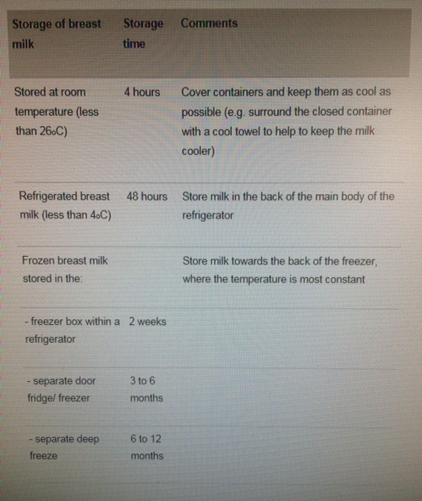
Guidelines for handling and storing expressed breast milk safely
You can store breast milk safely in a clean plastic or glass container with a lid. Until the baby is three months old, the container also needs to be sterilised. You can also freeze it.
Do not add new breast milk to other breast milk expressed earlier, especially frozen breast milk.
Adding new expressed breast milk to frozen breast milk may cause some of the frozen milk to thaw and then refreeze. This increases the risk of bacterial growth in the milk, which might harm the baby

Slide 20
How to thaw and warm expressed breast milk safely
Do not thaw or warm expressed breast milk in the microwave as this destroys the living cells in the milk.
To thaw expressed breast milk
Frozen breast milk can be thawed in the refrigerator or alternatively, put the container into a bowl of warm water.
Clean the cup or bottle before you put the thawed breast milk into it. Until the baby is three months old, the cup or bottle also needs to be sterilised
To warm expressed breast milk
Fill a bowl with hot water.
Put the cup or bottle containing the expressed breast milk into the bowl filled with hot water.
Before feeding, swirl the container of milk to mix and distribute the heat evenly. Then test the temperature of the expressed breast milk by shaking a few drops onto the inside of your wrist. If the milk is comfortably warm to the touch, it will be about the same temperature as fresh breast milk.
Expressed breast milk should not be warmed in the microwave.
Use warmed expressed breast milk within two hours.
Throw out any expressed breast milk left in the bottle after a feed, and wash and re-sterilise the bottle. Never reheat expressed breast milk more than once.

Slide 21
How to store and prepare powdered formula safely
Keep powdered formula covered and in a clean dry place. Check the use-by-date and use it within four weeks of opening.
As outlined above, clean all feeding equipment before preparing formula. Until the baby is three months old, you also need to sterilise all feeding equipment. Refer to the Cleaning and sterilising your baby’s feeding equipment section above.
To prepare powdered formula safely
Always thoroughly wash and dry your hands with soap and water before preparing bottle feeds.
Make sure the area used to make up the baby’s feed is clean.
Make up formula with cold, previously boiled water. For at least the first three months of the baby’s life, all water (including bought water), used to make up formula should be boiled and chilled on the same day it is to be used. To do this, bring water to a rolling boil on the stove top or if using an automatic kettle wait until it switches off. Keep boiled water covered while it cools and place in the fridge in sterilised bottles or a sterilised jug until it is needed. Keep this water for no longer than 24 hours. Water from tanks or bore holes should be boiled and cooled for babies and toddlers until they are about 18 months old.
Pour an appropriate amount of cooled boiled water into the cleaned and sterilised bottle before adding the powdered formula. Use the scoop and preparation instructions provided with the product. Never add more powder or less water than recommended and never add anything else into the formula feed.

Slide 22
If possible, infant formula should be made up just before a feed. Throw out any formula that has been out of the refrigerator for more than two hours.
Prepared formula can be stored for later use in the back of the refrigerator at less than 4°C. It should be stored for no longer than four hours.
Warming prepared formula safely
Formula can be heated by placing the bottle in a container of hot water.
Microwaves can heat unevenly. If you are using a microwave, shake the milk thoroughly after heating and leave it to stand for two to three minutes. Shake the formula again before using.
Test the temperature of the milk by shaking a few drops onto the inside of your wrist. The formula should feel comfortably warm to the touch.
Throw out any formula that is left in the bottle after a feed.
Do not reheat any prepared formula that has already been warmed or partially consumed.
Handling prepared formula safely when travelling
If you need to take a bottle of formula with you when travelling, take previously boiled and cooled water separate from the formula powder.
Measure the water into a clean container or the baby’s bottle. Until your baby is three months old, you also need to sterilise this container.
Carry the measured formula powder in a clean and sterilised container.
Prepare the formula just before using it, following the steps outlined above.

Slide 23
Be supportive and understanding. Breastfeeding is an important way for mothers to bond with their babies and provides many benefits to mothers, infants, and care givers. Breastfed babies usually:
get sick less often
spit up less
have less constipation
have less odour in stools
Create a quiet, comfortable space for nursing mothers in your child care setting. Some mothers may choose to come to child care and nurse the baby at mealtime. They may also wish to nurse their baby before they go home. Some breastfeeding mothers may feel comfortable nursing the baby while visiting with you and the other children, while others may prefer a quiet corner or another room.

Slide 24
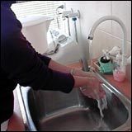
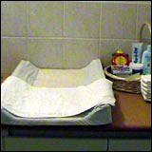
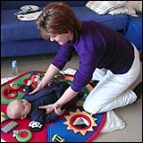
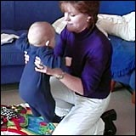
Nappy changing and toileting
When changing a child's nappy, keep everything that could be a safety hazard to the baby out of reach. This includes chemicals, pins and creams.
Changing nappies
There are a number of different things you should pay attention to when changing a nappy.
1
2
3
4
Wash your hands thoroughly, and dry them.
Make sure you have all the materials you need within your reach..
Let the child know that you are going to change their nappy. Always approach them from the front when picking them up or leading them to the change area.
Lift the child onto the change mat, using the correct lifting techniques as specified by workplace health and safety standards.

Slide 25
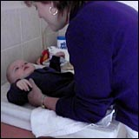
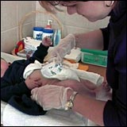
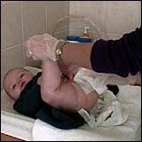
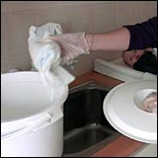
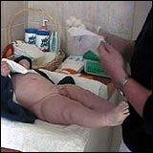
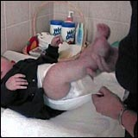
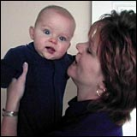
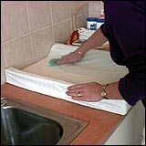
5
6
7
8
Interact with the child, for example, smiling and talking continuously whilst changing their nappy.
Undress the child then put gloves on to change their nappy. You should always wear gloves when changing nappies
Using a wipe clean in the creases of the baby's bottom, genitals and thighs. Apply creams or lotions, if needed.
(With parents permission)
Take the nappy off.
9
10
11
12
Remove your gloves without touching the outside of the glove and place them in a bin as soon as the soiled nappy is removed to prevent the spread of infection
Lift the child's legs up gently to place clean nappy underneath the child’s bottom. Put the baby's clothes back on, or replace them with clean clothes if necessary.
Wash the child's hands. Return the child to their play area.
Place nappy into Bin
13
14
Clean the change area with warm soapy water or disinfectant
Wash and dry your hands.

Slide 26
Toilet training
Although in Australia it is not common that children under the age of 2 years are toilet trained, a few children may begin at about 20 months old, depending on:
the child's readiness
their family members, values and beliefs
the season of the year.
Toilet training is an important time in a young child's life. It is a time for them to learn positive self-image and attitudes. It is yet another of the life tasks they will learn to do independently in the early years of their lives.
From time to time the child may be preoccupied in their play and they postpone leaving the play until it is too late to go to the toilet.
Remember, toilet training does not happen overnight. It is a very individual thing and the length of time it takes will vary between children. Even when you think the child is trained, accidents may happen. Especially if the child is unwell, you might find they may not feel up to toileting or they might just forget.
Just keep a positive attitude at all times!

Slide 27
Potty training a child who attends daycare or is under the occasional care of a caregiver other than a parent requires a team effort. Often, it is the very fact that a child is around other kids in underwear in a care setting that serves to motivate a young child to use the potty.
Parents and educators should discuss and agree on the planned potty training process. A consistent approach and common encouragement techniques can minimize confusion of a child during this time, and help to set the environment for a successful transition to becoming a big kid!
What should parents and educators discuss to help ensure a successful toilet training experience? Potty chair or no potty chair. Some children potty train using a kid-sized toilet. Others prefer to sit on the regular toilet with a potty seat on top. Parents should be sensitive to the needs of a child care provider, who is most likely watching other kids as well and who must keep hygiene, cleanliness and practicality as considerations to the training process as well. While it is not insurmountable to have different systems, having the same rules and same equipment certainly can be helpful for a child’s mastery of this process. Parents may even consider purchasing a potty chair (if the provider agrees this is a good idea) for their child’s use while in care that is identical to the one being used at home.

Slide 28
Nappies vs pull-ups vs. underwear. Opinions are varied about when and how long to use each of the above. Some parents swear by pull-ups, especially the ones that can be opened on the sides. Others prefer to bypass pull-ups altogether, and make the sole incentive as graduating from diapers into underwear. The argument is not which way is better; it is getting agreement on which route to take.
What should a child in potty training wear at naptime? Even a mostly-trained child may have accidents at naptime. Opinions vary as to whether a child should have a diaper or pull-up on at naptime, or whether accidents should be allowed to happen to encourage a child to feel the outcome. Of course, providers may not be as patient for having to sanitize mats and send home blankets and pillows on a routine basis due to accidents occurring. Dressing in practical clothing is a must. Parents sometimes do not take into consideration that a child in a bodysuit and overalls no matter how adorable they make look is incorrectly clothed for potty training. And, many a parent has been alarmed to see their child running around in a long shirt and underwear during these toilet training days while in daycare. The compromise, of course, is practical clothing that can be quickly and easily and the key word here is QUICKLY pulled down by a child independently in time to avoid an accident. Having hassle-free clothing is a key to a child's self-confidence and independence during this process. And, don't forget! During this training time, please ask parents to provide at least two sets of extra clothing and preferably a full package of underwear. Initially, a child may start to wet underwear on many occasions, and need to be changed.

Slide 29
Rewards and consequences. This is a conversation that absolutely should occur so as to not confuse a child and cause in regression in the toilet training process. How is a child rewarded for going potty? Is a reward applied if a child tries? Is a diaper put back on if a child refuses? How are accidents handled? One educator rewarded all the kids with one every time the child used the potty. Talk about positive peer reinforcement!.
House keeping.
If the child has soiled their clothing then the educator should rinse the clothes, before placing it in a plastic bag- Nothing worse then the parent getting home and pulling out soiled clothes. Consider the timing. In general, don't begin toilet training a child right after a big change such moving, divorce or remarriage, birth of a new sibling, a change in caregivers or daycare arrangements, or before a big holiday or event.
Celebrate together! A child who becomes toilet training is a major achievement both for the child as well as the educators! A great partnership and unified goals, consistency and open communication will help to achieve the desired results.

Slide 30
Safe preparation tips for powdered infant formula include:
Wash and dry hands, surfaces, utensils and equipment thoroughly
Sterilise bottles, teats, cups and tongs before use
Prepare formula exactly according to manufacturer’s instructions
Store made up formula immediately in a closed container in the coldest section at the back of the fridge
Discard after 24 hours if refrigerated or after two hours at room temperature
Rewarm by placing the container in heated, shallow water for no more than 15 minutes or use a commercial bottle warmer – don’t use a microwave as it reheats unevenly.
Tips for safely storing and rewarming expressed breast milk include:
Wash and dry your hands before expressing breast milk and use sterilised equipment.
Store breast milk in a sterile container, labelled with the date it was expressed, in the fridge or freezer.
Thaw frozen milk in the fridge and use it within 24 hours.
Rewarm expressed milk by standing the container in heated shallow water for no more than 15 minutes.
Do not re-freeze the milk and discard after four hours at warm temperatures.

Slide 31
Oral health in Babies and Toddlers
Primary teeth
Baby or primary teeth start to form in the jawbone before birth. A baby’s first primary tooth usually erupts at about six months of age but this can occur as early as birth or as late as the child’s first birthday. The average child has a full set of 20 primary teeth by the age of about three years. The first visit to the dentist should be within six months of the eruption of the first tooth or by the child’s first birthday.
Teething
The appearance of the primary teeth is commonly called ‘teething’. It’s not uncommon for babies to experience some discomfort during this time.
Most babies are irritable when new teeth break through the gums. Signs and symptoms of discomfort include:
**Frequent crying and crankiness
**A slight fever
**Reddened cheeks and drooling
**Appetite loss and upset stomach
**More frequent dirty nappies
**Sucking or gnawing on toys
** Pulling of the ear on the same side as the erupting
tooth
To help relieve the discomfort, the ADA recommends washing your hands, and then gently rubbing your baby’s gum with a clean finger. Alternatively you can give your baby a dummy, teething ring or wet washcloth to bite. Teething rings can be chilled in the refrigerator before use to help manage gum swelling and pain. (Do not put teething rings in the freezer.)

Slide 32
Attachment theory is focused on the relationships and bonds between people, particularly long-term relationships including those between a parent and child and between romantic partners.
What is Attachment?
Attachment is an emotional bond to another person. Psychologist John Bowlby was the first attachment theorist, describing attachment as a "lasting psychological connectedness between human beings."
Bowlby believed that the earliest bonds formed by children with their caregivers have a tremendous impact that continues throughout life. He suggested attachment also serves to keep the infant close to the mother, thus improving the child's chances of survival.
The central theme of attachment theory is that primary caregivers who are available and responsive to an infant's needs allow the child to develop a sense of security. The infant knows that the caregiver is dependable, which creates a secure base for the child to then explore the world.
Why Attachment Matters
Researchers have found that attachment patterns established early in life can lead to a number of outcomes. For example, children who are securely attached as infants tend to develop stronger self-esteem and better self-reliance as they grow older. These children also tend to be more independent, perform better in school, have successful social relationships, and experience less depression and anxiety.

Slide 33
The Stages of Attachment
Researchers Rudolph Schaffer and Peggy Emerson analyzed the number of attachment relationships that infants form in a longitudinal study with 60 infants. The infants were observed every four weeks during the first year of life, and then once again at 18 months. Based upon their observations, Schaffer and Emerson outlined four distinct phases of attachment.
Pre-attachment Stage: From birth to three months, infants do not show any particular attachment to a specific caregiver. The infant's signals such as crying and fussing naturally attract the attention of the caregiver, and the baby's positive responses encourage the caregiver to remain close.
Indiscriminate Attachment: From around six weeks of age to seven months, infants begin to show preferences for primary and secondary caregivers. During this phase, infants begin to develop a feeling of trust that the caregiver will respond to their needs. While they will still accept care from other people, they become much better at distinguishing between familiar and unfamiliar people as they approach seven months of age. They also respond more positively to the primary caregiver.
Discriminate Attachment: At this point, from about seven to eleven months of age, infants show a strong attachment and preference for one specific individual. They will protest when separated from the primary attachment figure (separation anxiety), and begin to display anxiety around strangers (stranger anxiety).

Slide 34
Multiple Attachments: After approximately nine months of age, children begin to form strong emotional bonds with other caregivers beyond the primary attachment figure. This often includes the father, older siblings, and grandparents.
While this process may seem straightforward, there are a number of different factors that can influence how and when attachments develop. First is the opportunity for attachment. Children that do not have a primary care figure, such as those raised in orphanages, may fail to develop the sense of trust needed to form an attachment. Second, the quality of care-giving is a vital factor. When caregivers respond quickly and consistently, children learn that they can depend on the people who are responsible for their care, which is the essential foundation for attachment.
Problems with Attachment
What happens to children who do not form secure attachments? Research suggests that failure to form secure attachments early in life can have a negative impact on behavior in later childhood and throughout the life. Children diagnosed with oppositional-defiant disorder (ODD), conduct disorder (CD) or post-traumatic stress disorder (PTSD) frequently display attachment problems, possibly due to early abuse, neglect or trauma. Clinicians suggest that children adopted after the age of six months have a higher risk of attachment problems.
While attachment styles displayed in adulthood are not necessarily the same as those seen in infancy, research indicates that early attachments can have a serious impact on later relationships. For example, those who are securely attached in childhood tend to have good self-esteem, strong romantic relationships and the ability to self-disclose to others. As adults, they tend to have healthy, happy and lasting relationships.

Slide 35
Connecting and communicating:
Touch, cuddle and sing softly. These are first forms of communication. When babies cry, you can reassure them with your presence and a comforting, soothing tone. Babies respond to the emotions you’re communicating through what they see, hear and feel. They react to your sadness, tension, happiness or satisfaction.
Be aware that tone and body language make a difference. When babies hear ‘Stop!’ they’ll sometimes cry. This is because they’re reacting to the sharpness and volume of your command. In the same way, a soft, loving ‘good night’ when you’re tucking baby into bed will be comforting because of the soothing tone.
Stay physically connected. This is another way to communicate. Babies like being close to their parents. Holding them next to your body communicates reassurance and comfort
Turn baby talk into a two-way conversation. Invite responses from the baby. Singing and chanting nursery rhymes are good ways to play with sound. They invite baby to make a pleasing stream of sounds that eventually lead to talking.
Extend sounds and words to help children develop language skills. If your toddler says ‘Go home’, you might extend this thought by saying, ‘You want to go home. We can leave in a few minutes’.
Even if you’re not sure how much your child understands, talk anyway! Just like holding and kissing, words are an important way of staying in contact with the baby. They’ll help the baby begin to attach feelings and thoughts to sounds.

