Slide 1
Supervision

Slide 2
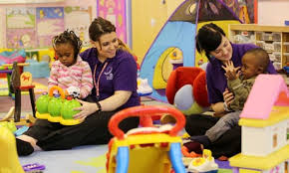
Children need safe, secure child care environments which are effectively supervised.
Educators have a duty of care to ensure all areas accessible to children are safe, free from hazards, and there are sufficient educators to oversee the children’s activities.
The type of supervision required, however, will change depending on the program and activities, the layout of the physical space, and the individual needs of the children.

Slide 3
Active Supervision is….
Direct and constant monitoring by Educators in close proximity to children is useful for actively supervising activities that involve some risk, for example wood work activities, cooking experiences and any children’s play that is in or near water
Careful positioning of Educator’s to allow them to observe the maximum area possible. By moving around the area Educator’s can then ensure the best view possible, and that they are always facing the children
Scanning or regularly looking around the area to observe all the children in the vicinity is useful when educators are supervising a large group of children

Slide 4
Listening closely to children near and far will help to supervise areas that may not be in the educator’s direct line of sight.
Observing children’s play and anticipating what may happen next will allow educator’s to assist children as difficulties arise and to intervene where there is potential danger to children
Balancing activities to ensure risk is minimised and there are sufficient educator’s to attend to children’s needs

Slide 5
Tools to aid effective supervision
Conduct safety checks
The child care environment should be inspected and monitored for hazards that could lead to poisoning or injury. Services should have safety check systems in place that allow educator’s to easily monitor, report and remove hazards.
Position educators in close proximity to children
Educator’s should be close enough to children to intervene promptly and prevent injury. This is particularly important when children are attempting an activity for the first time or
Educators should ensure that play areas designed for safety will also assist in the supervision of children and will include:
Safe fall zones
Good traffic flow
Ongoing maintenance of buildings and equipment
Minimal trip hazards
Platforms with guardrails
Equipment that does not have pinch points, sharp edges, things that protrude or tangle or that may cause entrapment

Slide 6
Supervision on excursions
A greater ratio of educators to children will often be required when taking children on an excursion outside the service premises.
Monitor children’s health
Children with early signs of illness and atypical behavior should be closely monitored and appropriate action taken.
Supervise children’s departure
When supervising children’s daily departure from the service, educators should be aware of the people who have the authority to collect the child. The service should only ever release children into the care of authorised people.
Observe play and behavior
Children’s play and behaviour should be observed to ensure no injury or harm occurs.

Slide 7
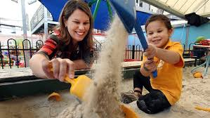
Position equipment and arrange the environment
Well designed environments will take supervision into account and allow educators to monitor children’s play with ease.
Constant supervision near water
Services must comply with licensing regulations and/or national standards when supervising children in or near water. Any activity where children play with, near or in water poses a high safety risk.

Slide 8
How do we ensure consistent
supervision by staff and educators?
There are many moments in the busy day-to-day operations of a child care service where educator’s will need to respond flexibly to children’s and families’ needs whilst maintaining supervision standards.
Educators rosters and routines should be designed to maximise the consistency of supervision of children by ensuring that:
Required educator to child ratios are maintained at all times
Educators are available to greet and farewell children and families on arrival and departure
Supervision standards are maintained during educator breaks
The children’s program and experiences are well supported by active supervision by Educators
Children are well supervised during toileting/ nappy change routines, meal times and rest periods

Slide 9
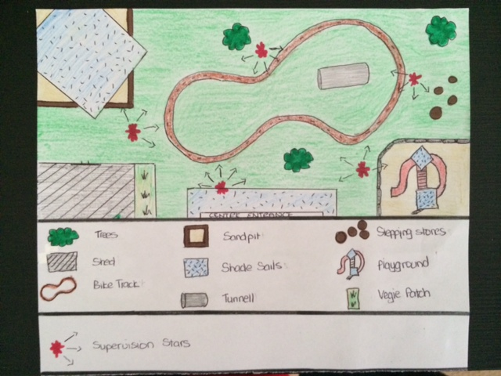
Supervision stations
Yellow stars indicate where staff are required to stand. The arrows indicate where the educator must position his/her body towards those directions
Sandpit
Shade sails
Tunnel
Stepping stones
Play ground
Vegie patch
Trees
Shed
Bike Track
Supervision Stars

Slide 10
Ratios
.
The table below summarises the minimum national educator-to-child ratios:
Over preschool age (that is, school age children) The National Quality Framework has been agreed to at this stage to include children over preschool age, however the National Quality Framework does not include a National Standard for children over preschool age—see individual jurisdiction arrangements
Please note: Some jurisdiction-specific requirements override the national educator-to-child ratios.
Age | Educator to child ratio | Compliance timeframe
Birth to 24 mths | 1:4 | 1 January 2012
25 to 35 months | 1:5 | 1 January 2016
36 months up to including preschool age | 1:10 | 1 January 2016

Slide 11
Educators who are under 18 to be supervised
The approved provider of a centre-based service must ensure that any educator at the service who is under 18 years of age does not work alone at the service; and is adequately supervised at all times by an educator who has attained the age of 18 years
Number of children who can be educated and cared for—family day care educator
A family day care educator must not educate and care for more than 7 children at a family day care residence or approved family day care venue at any one time.
In determining the number of children who can be educated and cared for by a family day care educator no more than 4 can be preschool age or under and if the children are being educated and cared for at a residence, the educator's own children and any other children at the residence are to be taken into account if—
those children are under 13 years of age; and
there is no other adult present and caring for the children.
No more than 7 children can be educated and cared for as part of a family day care service at a family day care residence or an approved family day care venue at any one time.

Slide 12
References:
Bender, J., Flatter, C H., and Sorrentino, J M. (2000) Half A Childhood. Quality Programs for Out-of-School Hours, School- Age NOTES, Nashville, Tennessee.
Department for Community Development, Government of Western Australia. (2002) Outside School Hours Care Licensing Manual First Edition. Department for Community Development, Government of Western Australia.
New South Wales Department of Community Services. Children's Services Regulation 2004
New South Wales Department of Community Services (2002). NSW Curriculum Framework for Children’s Services: The Practice of Relationships, Essential Provisions for Children’s Services. Office of Childcare, New South Wales.
http://www.communities.wa.gov.au/education-and-care/nqfgb/regs/Pages/6regs404.aspx#div002

