Slide 1
Sustainability Part 1

Slide 2
What is sustainability
It is a natural progression from children appreciating and enjoying nature to understanding that nature is fragile and its resources are finite.
Sustainable practices are things we can do to help our communities, suburbs, towns, cities, farms, parks and open spaces.
The best way to help children to care about the environment is to start in our own back yard. One person can make a difference in the world, a group of people making small changes can have a bigger impact.
Make sure to involve children and their families. When planning experiences for children try to include sustainable practices or theory.
Simply put, educators are to be ‘Earth Smart’ and to ensure that their every action accords with this. They also need to talk about their commitment with the children and listen to any ideas that children may have.

Slide 3
Firstly, we need to look at the definitions of built and natural environments as defined by the NQS.
Built environments include manufactured, synthetic and commercially produced surfaces, materials, toys and equipment.
Natural environments include natural materials and surfaces which have undergone very little modification, for example, grass, trees, rocks, plants, materials, soil, sand, water, clay, timber, bark, seeds, shells and stones.
Three ways services can develop children’s appreciation, and respect for nature, are:
Beautiful moments are just that – nature putting on a show. If, say, rainbow lorikeets are feeding noisily on the blossoms of a gum tree, draw it to the children’s attention in more than a superficial way. If the clouds are an unusual shape or are moving quickly across the sky, or the sky is piercingly blue with no clouds, share your observations and delight with the children.
Take advantage of moments such as these to develop children’s ‘spirituality’ – that sense of awe and wonder, that connection with nature.
Gardening Most children love being outdoors digging in the soil, getting dirty, creating and watching plants grow. In addition, gardening is educational and develops personal attributes such as cooperation, understanding, responsibility and creativity.

Slide 4
Our Children – are our future and will be the caretakers of our environment Sustainable practices are embedded in the children's daily routine and in their day-to-day activities, these include:
Using recyclable materials where possible.
Encouraging children to use half flush on the toilets,
Encouraging children to turn the water off when they have washed their hands,
Encouraging children to recycle paper and rubbish within their rooms, at home and when in the wider community,
Talking with the children about electricity and encouraging them to turn off lights,
Educating children in the natural decomposition cycle through exposure and participation in worm farms and composting food scraps,
Educating children and having them participate in ‘garden to plate’ activities i.e. seed sprouting, weeding, vegetable gardens, cooking amongst other activities,
Educating children in how to care for pets and letting them actively participate in caring for the Centre pet,
Educating children on caring for plants and our waterways i.e. recycling water etc

Slide 5
Our Families and wider community – are the guardians of our most
important assets
Our families and the wider community are encouraged to adopt sustainable practices and share ideas as a commitment to our children and their future, these include:
Accessing the displays and literature provided about environmental protection at each Centre,
Promoting the use of environmentally friendly products in the home (where possible),
Recycling to reinforce Centre practices around sustainability,
Participation in Centre activities, events and forums relating to conservation, sustainability and maintaining a healthy environment,
Reusing materials where possible e.g. boxes for craft,
Building partnerships with our educators in teaching our children sustainable practices at home i.e. turn off taps when brushing teeth, having shorter showers, turning off lights, putting on a jumper instead of turning the heater on etc.

Slide 6
Our Educators – are the early learning framework that scaffolds
the future of our children
We will embrace the learning opportunities we provide to our children, families and the wider community, these include:
Using natural resources where possible such as drying washing outdoors in the sun,
Promoting awareness of the environment through ‘green housekeeping practices’ such as healthy eating, gardening, minimising waste, recycling and reducing water and energy consumption.
Assist children in developing an understanding and respect for the environment and encourage critical thinking.
Working with children and families to research the native wildlife.
Role modelling practices that encourage sustainability through recycling, water conservation, electricity usage etc, this includes:
Educators, educating children about caring for our environment.
Recycling water from water play into the gardens,
Emptying the children’s drinking bottles onto the garden,
Asking families to bring in recyclable items to use for arts and craft,
Utilising environmentally friendly products (where possible).

Slide 7
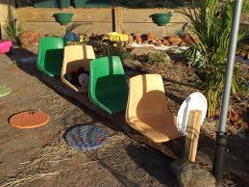
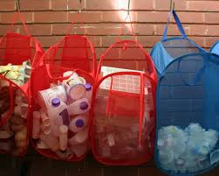
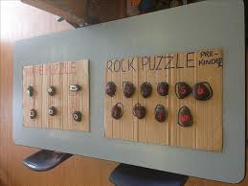
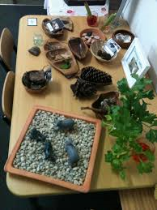
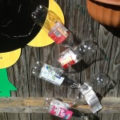
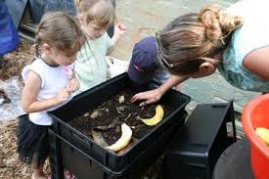
What does sustainability looks like ?

Slide 8
Bringing the outside in
Natural environments do not have to stay outside. The natural environment can be used to enhance the children’s indoor program.
Ways to bring the outside in include:
Display outside items of all types – bits of branches, bark, feathers, shells, driftwood, fronds in open shelving or a bookcase.
Gather pine cones, seed pods, leaves, gumnuts, and small stones. Children can use them to explore simple science and maths concepts such as classifying, counting and weighing – or simply to enjoy or use in their art and craft.
Add pot plants. They not only bring the outside in, but meet the requirement of an aesthetic environment.
Provide sand and water trays for younger children.
Make nature walls. Use a large piece of hessian and have the children attach any interesting natural items they find.
Construct collages made of rocks or shells and hang them.

Slide 9
Natural cleaning alternatives for use in the education and care
environment.
Natural or chemical-free options that are sensitive to the needs of educators and children with allergies will be utilised when possible.
Support children to have an active role in caring for their environment and to contribute to a sustainable future.
• Seek to minimise the use of chemicals in the education and care environment.
• Consider sustainable practice when they are cleaning. They will reflect on their practices and access professional development, journals and the Internet for more ideas on eco-friendly cleaning options.
• Use soapy water for daily cleaning of tables, nappy change surfaces, mouthed toys and general spills both indoors and outside. The soapy water can be made from pH Neutral detergent diluted in water and stored in a labelled spray bottle out of reach of children.
• Consider the use of vinegar and water as an alternate to disinfectant for cleaning the bathrooms and nappy change mats throughout the day. The vinegar and water can be made in a labelled spray bottle with equal parts of white vinegar and water and stored out of reach of children.

Slide 10
• Consider using the following:
Bicarbonate of Soda (made into a paste) – replaces Jif and Gumption.
Lemon juice – an alternate to bleach.
Borax – alternate to bleach, disinfectant and insect sprays.
Bees wax – alternate to furniture and floor polish.
Aim to minimise waste by:
Encouraging recyclable materials to be placed in labelled recycling containers rather than garbage bins.
Recycling food scraps at meal and snack times. Children and educators can place food scraps into these containers which will then be placed in composting or worm farm containers. The kitchen will have containers for food scraps and recycling for educators to use.

Slide 11
Get help: If you feel overwhelmed by the responsibility, or just by the sheer amount of available information, find someone to talk to. In some states there are established sustainability networks that you may be able to join (see the links and resources section of this newsletter for some suggestions); in other cases you might be able to speak to your local council or find other early childhood services that are already incorporating sustainability and are happy to share their ideas and expertise.
If funding is an issue, find out what grants are available that you may be able to apply for. The existing sustainability network groups will be able to help you identify those that are most suitable for early childhood services.

Establish a starting point: A self-assessment or an audit conducted by someone else will help to identify what you already do. It will also help to establish a baseline for your use of resources. How much electricity, water and gas do you
use? How many paper towels and tissues? And what cleaning chemicals? How much garbage do you throw away? How much recycling?
On the basis of what you find out there may be some easy and obvious steps to take to reduce your consumption—turning off lights and taps, opening windows to let in the breeze, recycling and composting waste.

Slide 12
Talk to children, families and colleagues: Develop a shared understanding of what sustainability might look like in your service. Find out what skills, knowledge and experience others might have to contribute.
. Be realistic: Start small and remember to set manageable and achievable goals. No one can do everything all at once. Develop a plan so that you have an idea of what you are trying to achieve over time. A vegetable garden and a worm farm are a good start but what will you do next?

Make it meaningful: Work on ways to incorporate sustainability into your program in meaningful ways. Sustainability doesn’t work as an ‘add-on’ or occasional experience—to be successful it needs to be embedded into
what you do on a day-to-day basis.

Slide 13
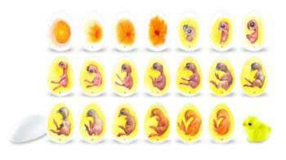
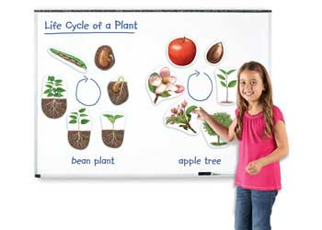
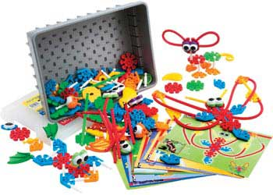
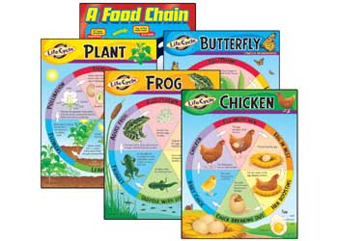
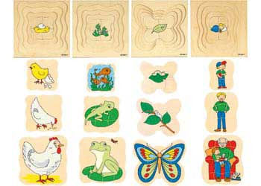
Interdependence between people, plants, animals and the land
Here are some human made resource to assist in teaching children about the world around them
The life cycle magnet board
Grow insect puzzles
Knex creaturesand life cycle
Grow insect puzzles
Grow insect puzzles
Life cycle charts

