Slide 1
Sustainability Part 2

Slide 2
Features that enable children to explore and experience the
natural environment
A natural environment in a children’s service is an environment which
Includes natural elements.
Natural environments may include:
• gardens where children can grow their own plants
• sandpits for sensory, symbolic and physical play
• digging patches where children can use garden equipment
• a range of planting to encourage a variety of modes of play such as playing with gum nuts, small branches, flowers, stones and bark
• small pits of pebbles, gravel, course sand and smooth river rocks for fine
motor and imaginative play
• plants for picking and eating
• plants that encourages birds, butterflies and other insects
• trees which provide shade
• worm farms and compost areas for environmental education
• water play areas for sensory play.

Slide 3
Children and adults in natural environments
An interesting and dynamic outdoor play space which includes natural features
adds interest and stimulation to the program provided and creates additional
variety for children’s learning and allows children to explore and experience the
natural environment. These spaces invite open ended interactions, spontaneity,
risk taking, exploration, discovery and connection with nature. They foster an
appreciation of the natural environment, develop environmental awareness and
provide a platform for ongoing environmental education.
Children’s learning and development in natural environments
When children are using the natural environment to develop knowledge in
this area this is evidenced by children:
• showing a growing concern and appreciation for natural environments
• exploring relationships with other living and non living things
• observing, noticing and responding to changes in the environment
• developing an awareness of the impact of human
activity on environments and the interdependence of
living things.

Slide 4
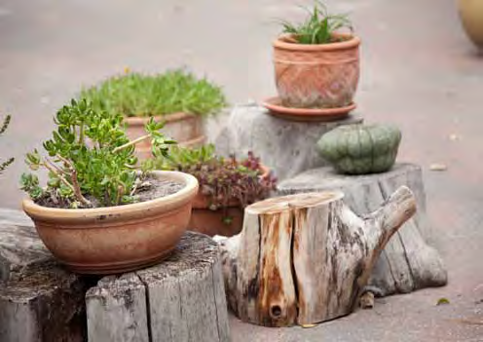
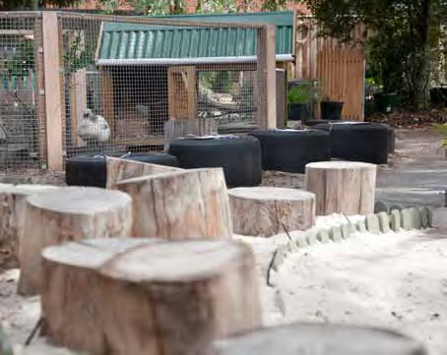
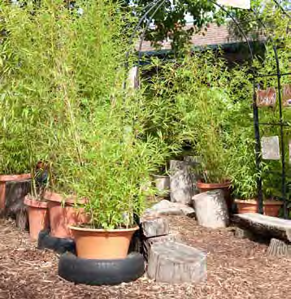
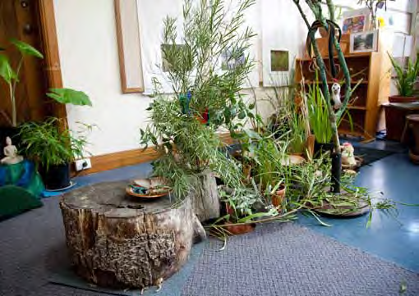
Dividing areas
Areas can be divided both inside and outside by using sawn off logs, plants in large pots and wooden fences. Planter boxes and bamboo poles can be used to divide outside play areas.

Slide 5
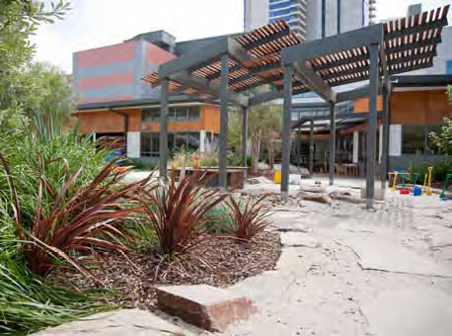
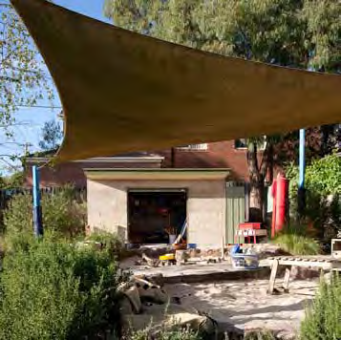
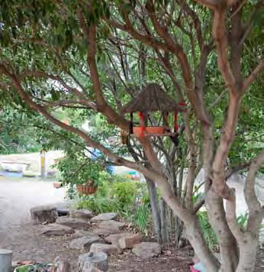
Providing shade
Shade cloth is most commonly used for providing shady play areas, however creeping plants and vines and trees can also provide shade.

Slide 6
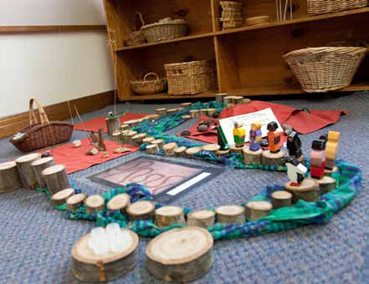
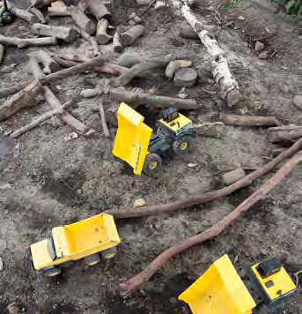
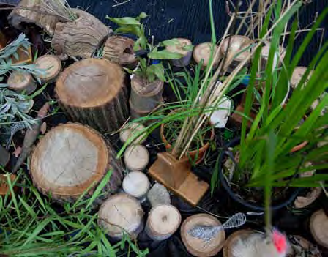
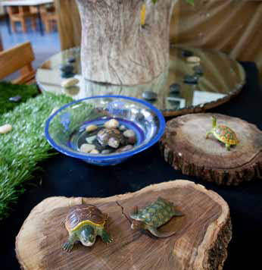
Using logs and branches
Logs and branches from trees can be used in creative ways in both the inside and outside play spaces. Sawn off logs can be used for seating and for dividing areas
of the playground. Twigs and branches can be placed in the digging patch and sandpit for adding interest and variety. Small logs can be used to add interest to indoor block play with small figures or animals. Non-traditional block sets will also encourage pretend play.

Slide 7
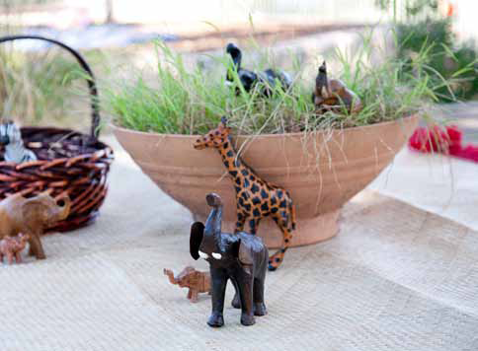
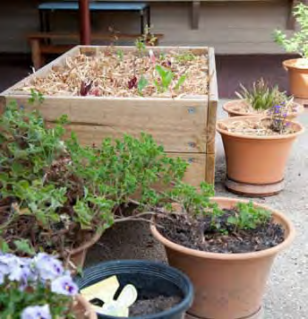
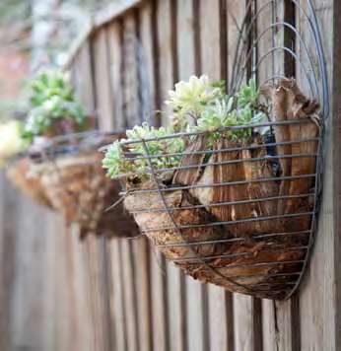
Growing plants
Plants can be grown for smelling, picking and eating. Herbs and flowering plants attract different insects, birds and butterflies. Using waist-high corrugated iron and wooden containers allow children and adults to access the plants more easily. Plants can be grown in small pots for use in play or on fences in baskets.

Slide 8
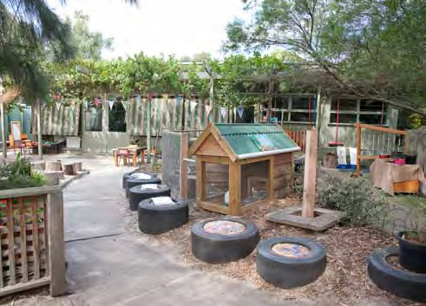
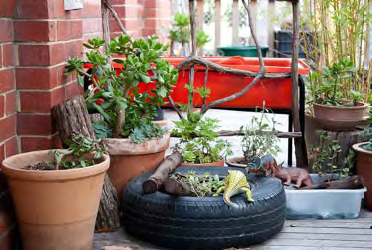
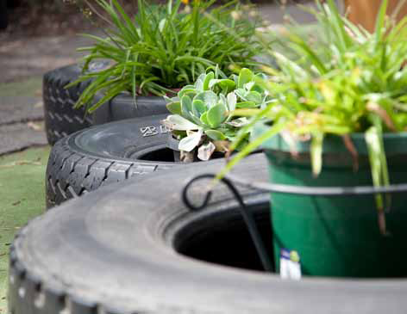
Use of tyres
Car or truck tyres can be used in many ways. Tyres can be filled with different sensory materials and they can be used for planting or holding pot plants. Tyres can be used for dividing areas and storing toys and materials.

Slide 9
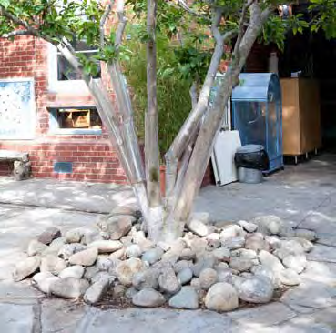
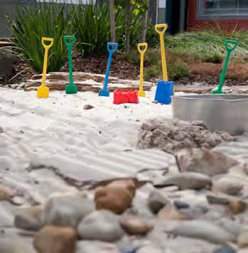
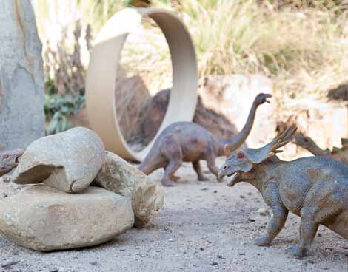
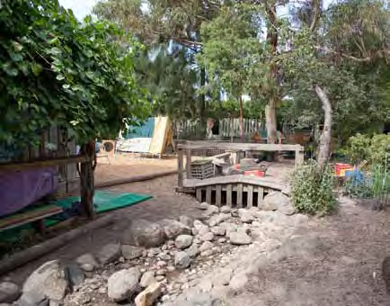
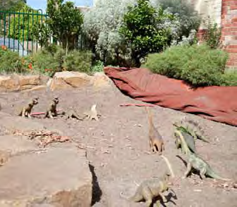
Stones and rocks
Large stones can surround sand pits and digging patches for sitting on or using in play. Creek beds may be constructed for children to play in or for water play. Stones around a tree add interest. Wet
stones provide another avenue for sensory play.

Slide 10
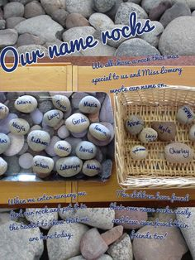
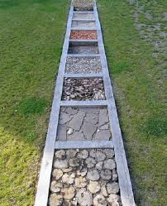
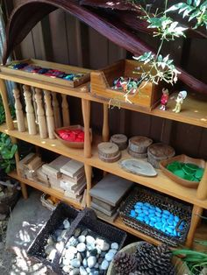
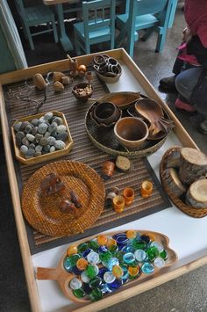
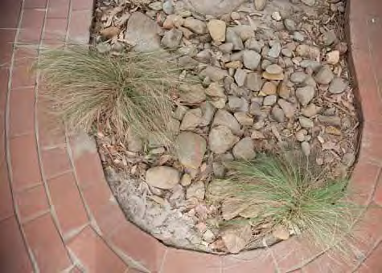
Small stones used for
ground cover Small pebbles and stones can be used in parts of the playground to add interest and provide more sensory
experiences for children.

Slide 11
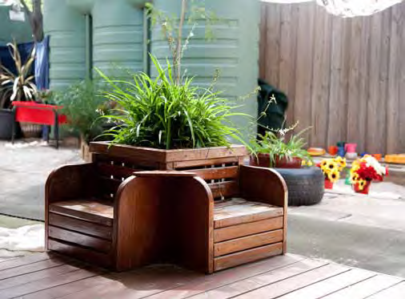
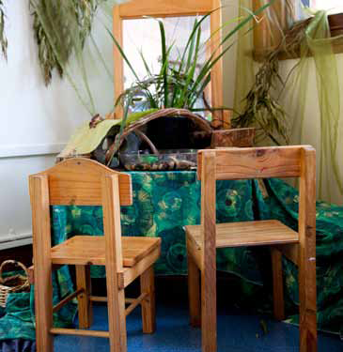
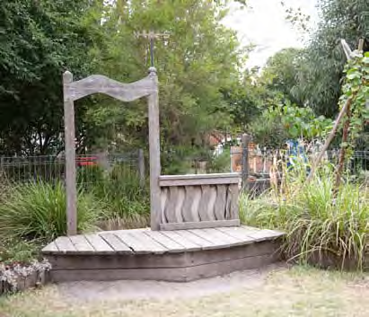
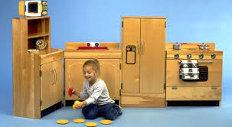
Wooden furniture
Wooden furniture can add variety to play spaces. This furniture may be built in or may be moved about.

Slide 12
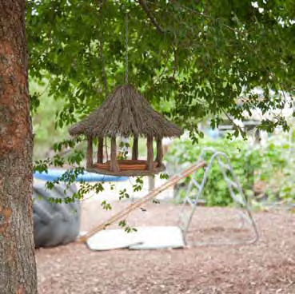
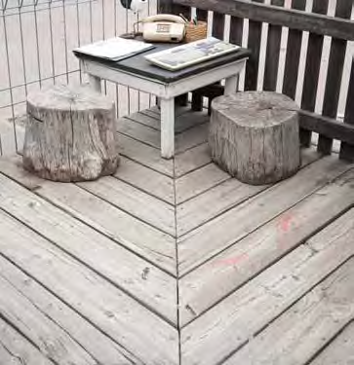
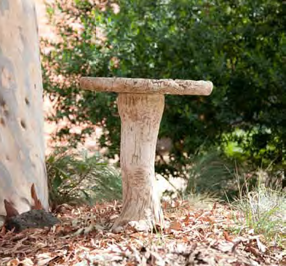
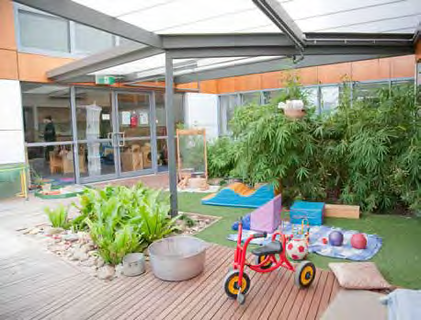
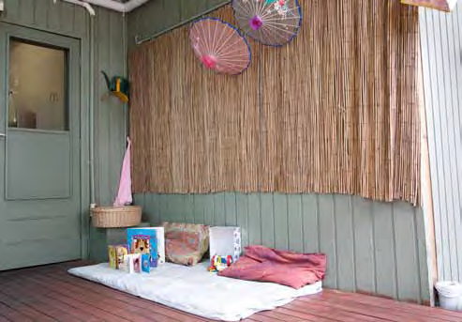
Wooden structures
Wooden edging next to sandpits can be used for seating or for play. Platforms allow for special spaces for small group play. Decking can be used to define areas and allow for different tactile experiences. Bird baths, cubbies and sheds made of wood make for a more attractive environment and give children small spaces in which to play.

Slide 13
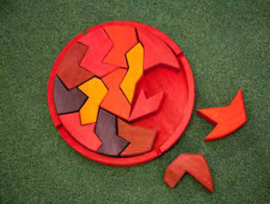
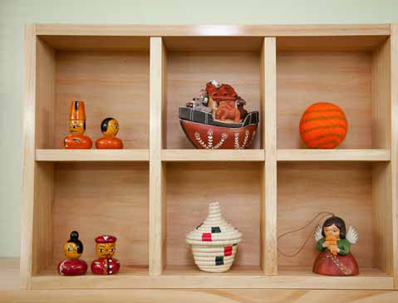
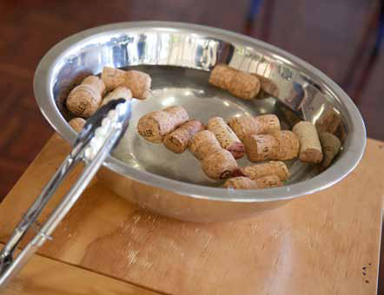
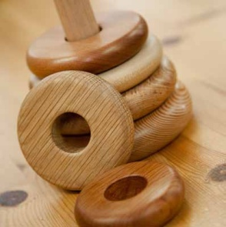
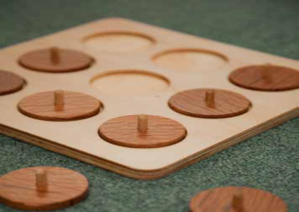
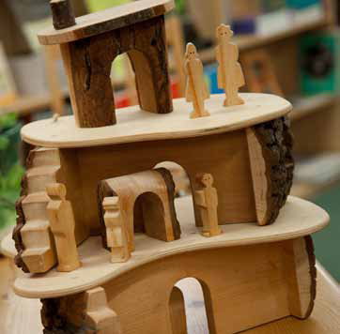
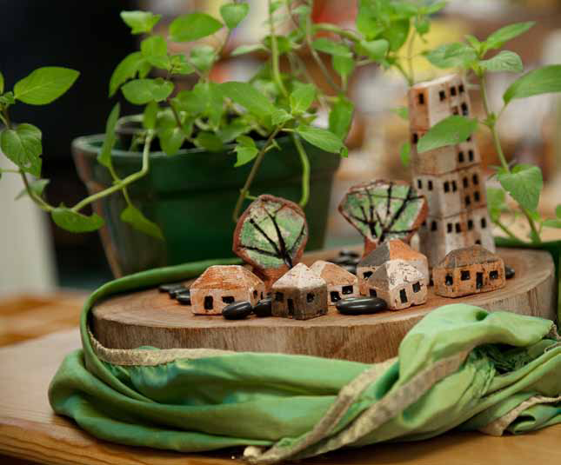
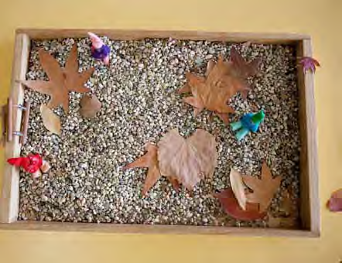
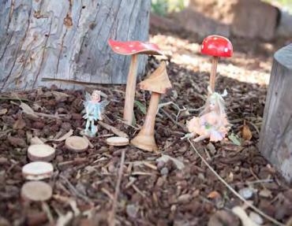
Wooden toys and natural play
materials – inside and out
There are many toys available to purchase. Small figures and objects can add interest to pretend play and well constructed traditional toys made from wood are useful additions to the materials presented to children. These provide tactile and sensory experiences not provided by plastic toys. Baskets can be used to store material and equipment for the children to play with. Small sand boxes inside can be filled with small pebbles, sawdust or sand for indoor or outside play.

Slide 14
Above all – let children PLAY with nature and around nature!

